Slide 1


Hackathon 2023

Slide 2

Sketching with Electronics
Arduino: Open Source Imagination
Daniel Spikol DIKU HCC
Anders, Casper, Christian, Jeppe, Laufey, Nanna, Nicolaj, and Sofie
Studiestart 2023 Arduino Hack

Slide 3

SLIDES: https://bit.ly/3TplF4D
These slides

Slide 4

Join Abasalon course: https://absalon.ku.dk/enroll/AJ9KNJ
Absalon

Slide 5
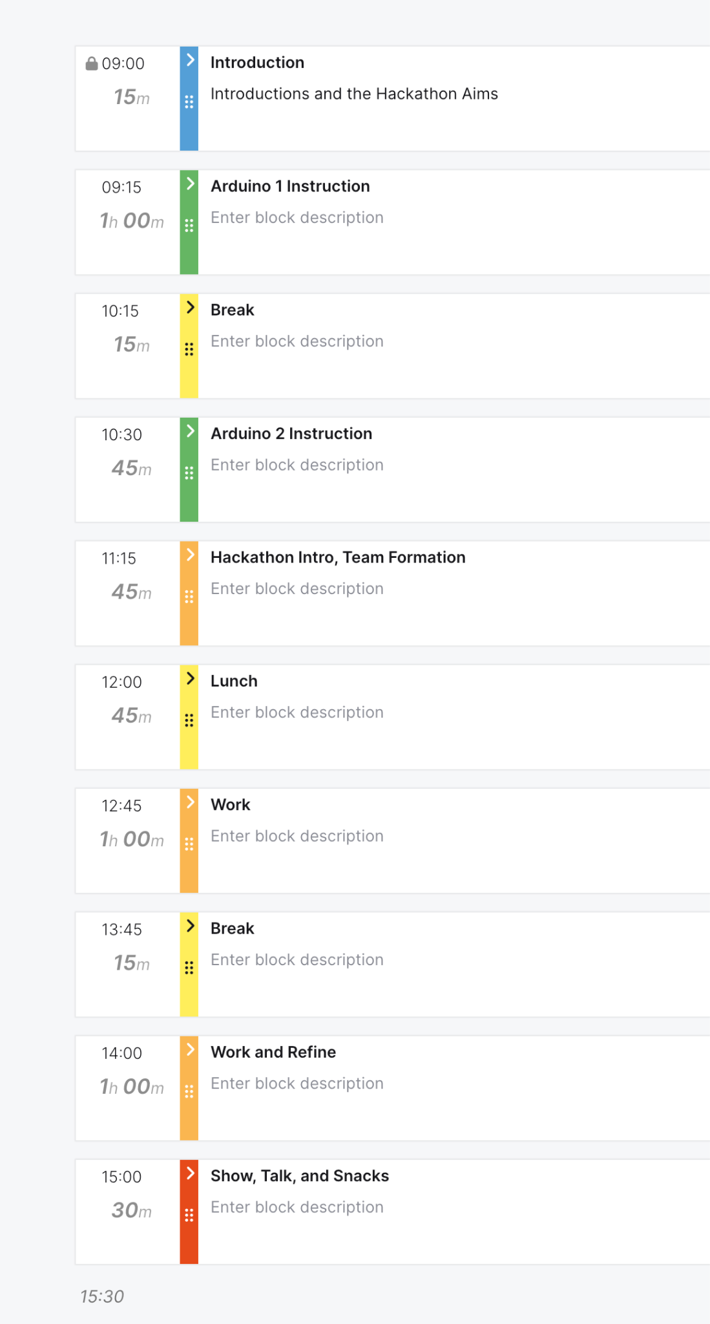
Todays Menu
Intros & Hello’s
Hands-on workshop with Arduino
Ideation
Project time
Show, Talk, and Snacks

Slide 6
“The philosophy behind Arduino is that if you want to learn electronics, you should be able to learn as you go from day one, instead of starting by learning algebra”
David Cuartielles
David Kushner (2011-10-26). "The Making of Arduino". IEEE Spectrum https://spectrum.ieee.org/geek-life/hands-on/the-making-of-arduino-
Notes:
Originally started as a research project by Massimo Banzi, David Cuartielles, Tom Igoe, Gianluca Martino, and David Mellis at the Interaction Design Institute of Ivrea in the early 2000s, it builds upon the Processing project, a language for learning how to code within the context of the visual arts developed by Casey Reas and Ben Fry as well as a thesis project by Hernando Barragan about the Wiring board.
The bar is the watering hole of Massimo Banzi, the Italian cofounder of the electronics project that he named Arduino in honor of the place. Arduino is a low-cost microcontroller board that lets even a novice do really amazing things. You can connect an Arduino to all kinds of sensors, lights, motors, and other devices and use easy-to-learn software to program how your creation will behave. You can build an interactive display or a mobile robot and then share your design with the world by posting it on the Net.

Slide 7
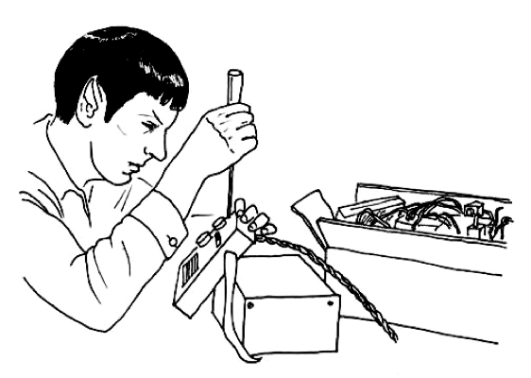
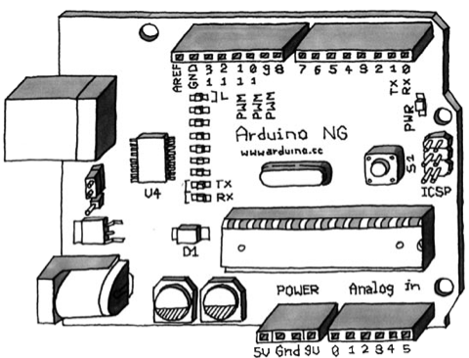
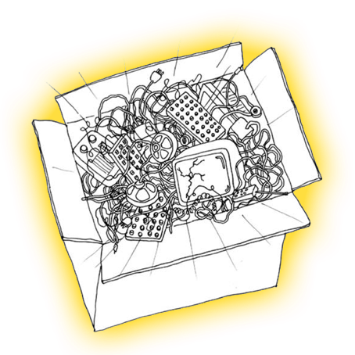
Feel it, Tinker
Junk is Gold
Arduino, what is that?
Notes:
In this course you will not learn in a traditional academic way.
We believe that you can learn electronics

Slide 8

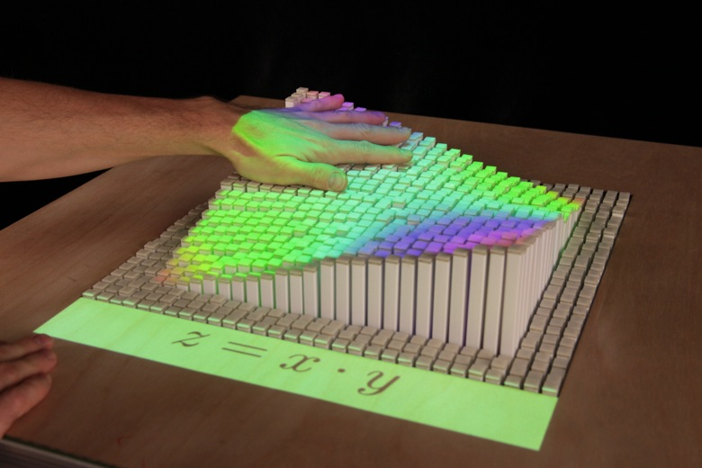
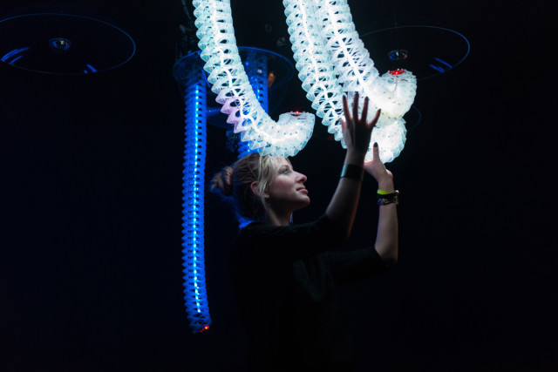
From Art to Science and to STEAM

Slide 9

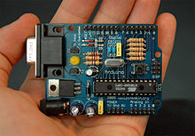
Scope of Arduino
Released in 2005 as a modest tool for Banzi’s students at the Interaction Design Institute Ivrea (IDII)
Join 433 244 hardware developers who follow Arduino on Hackster.io alone…
Over a three month period in 2017, 42 million visits to the Arduino website came from recurring users–the die-hard makers.
In June 2023 arduino.cc received 7.9M visits
Notes:
The Arduino core team today—David Cuartielles & Massimo Banzi, plus Tom Igoe & David Mellis

Slide 10
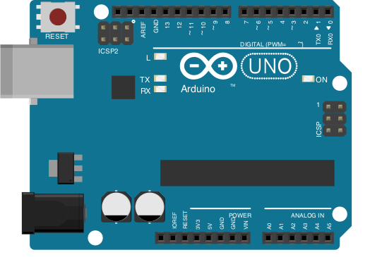
The Pins
Digital Pins 0 to 13
Reset Switch
USB Connector
Power Connector 6v-24v
Power Outputs
Analogue in
Notes:
Explain the 5 comments.
Digital pins operate in 0’s and 1’s On or Off.
Analog pins work as inputs.
Explain link between Arduino and computer: Arduino is able to get control electrical components like LED’s and speakers and Arduino is able to measure values in the physical world.
Measure inputs control outputs
3.3 volts and 5 volt power pins to power electrical components (sensors and actuators)
Vin = maximum 17 volts. Vin is the power from an external power source, used to power motors for example.
Arduino takes between 6 and 17 volts The worst thing that could happen is you fry the chip on the Arduino board.

Slide 11
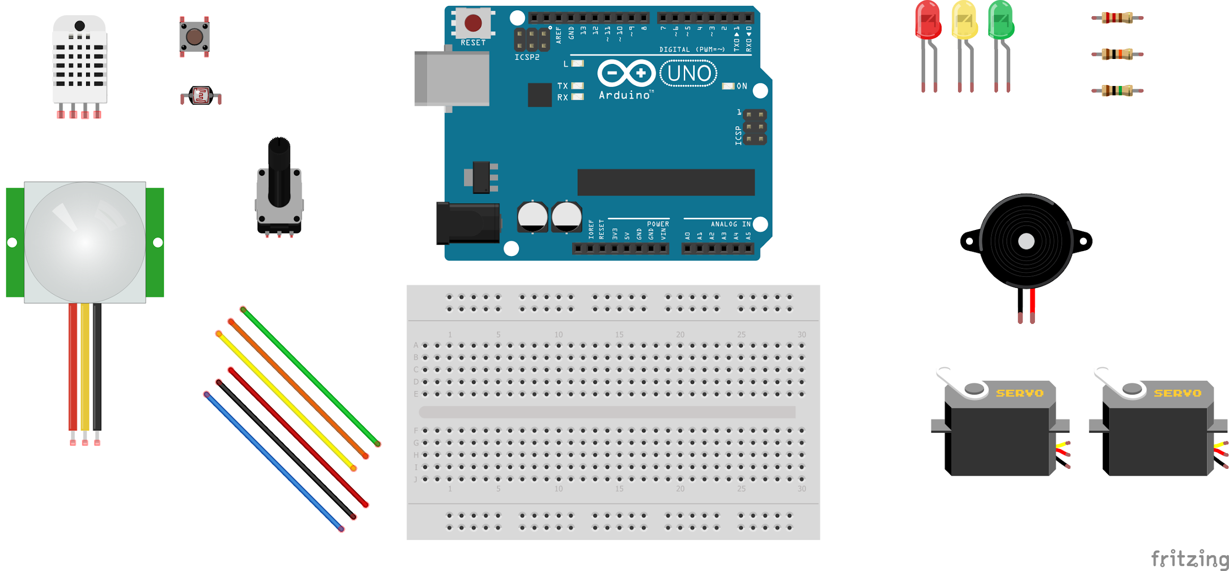
The Kit
Button
Light Diode Resistor
LEDs
Resistors
Temperature
Potentiometer
Piezo Speaker
PIR
180 Servo & Continuous Servo
Wires and Jumpers
Breadboard

Slide 12
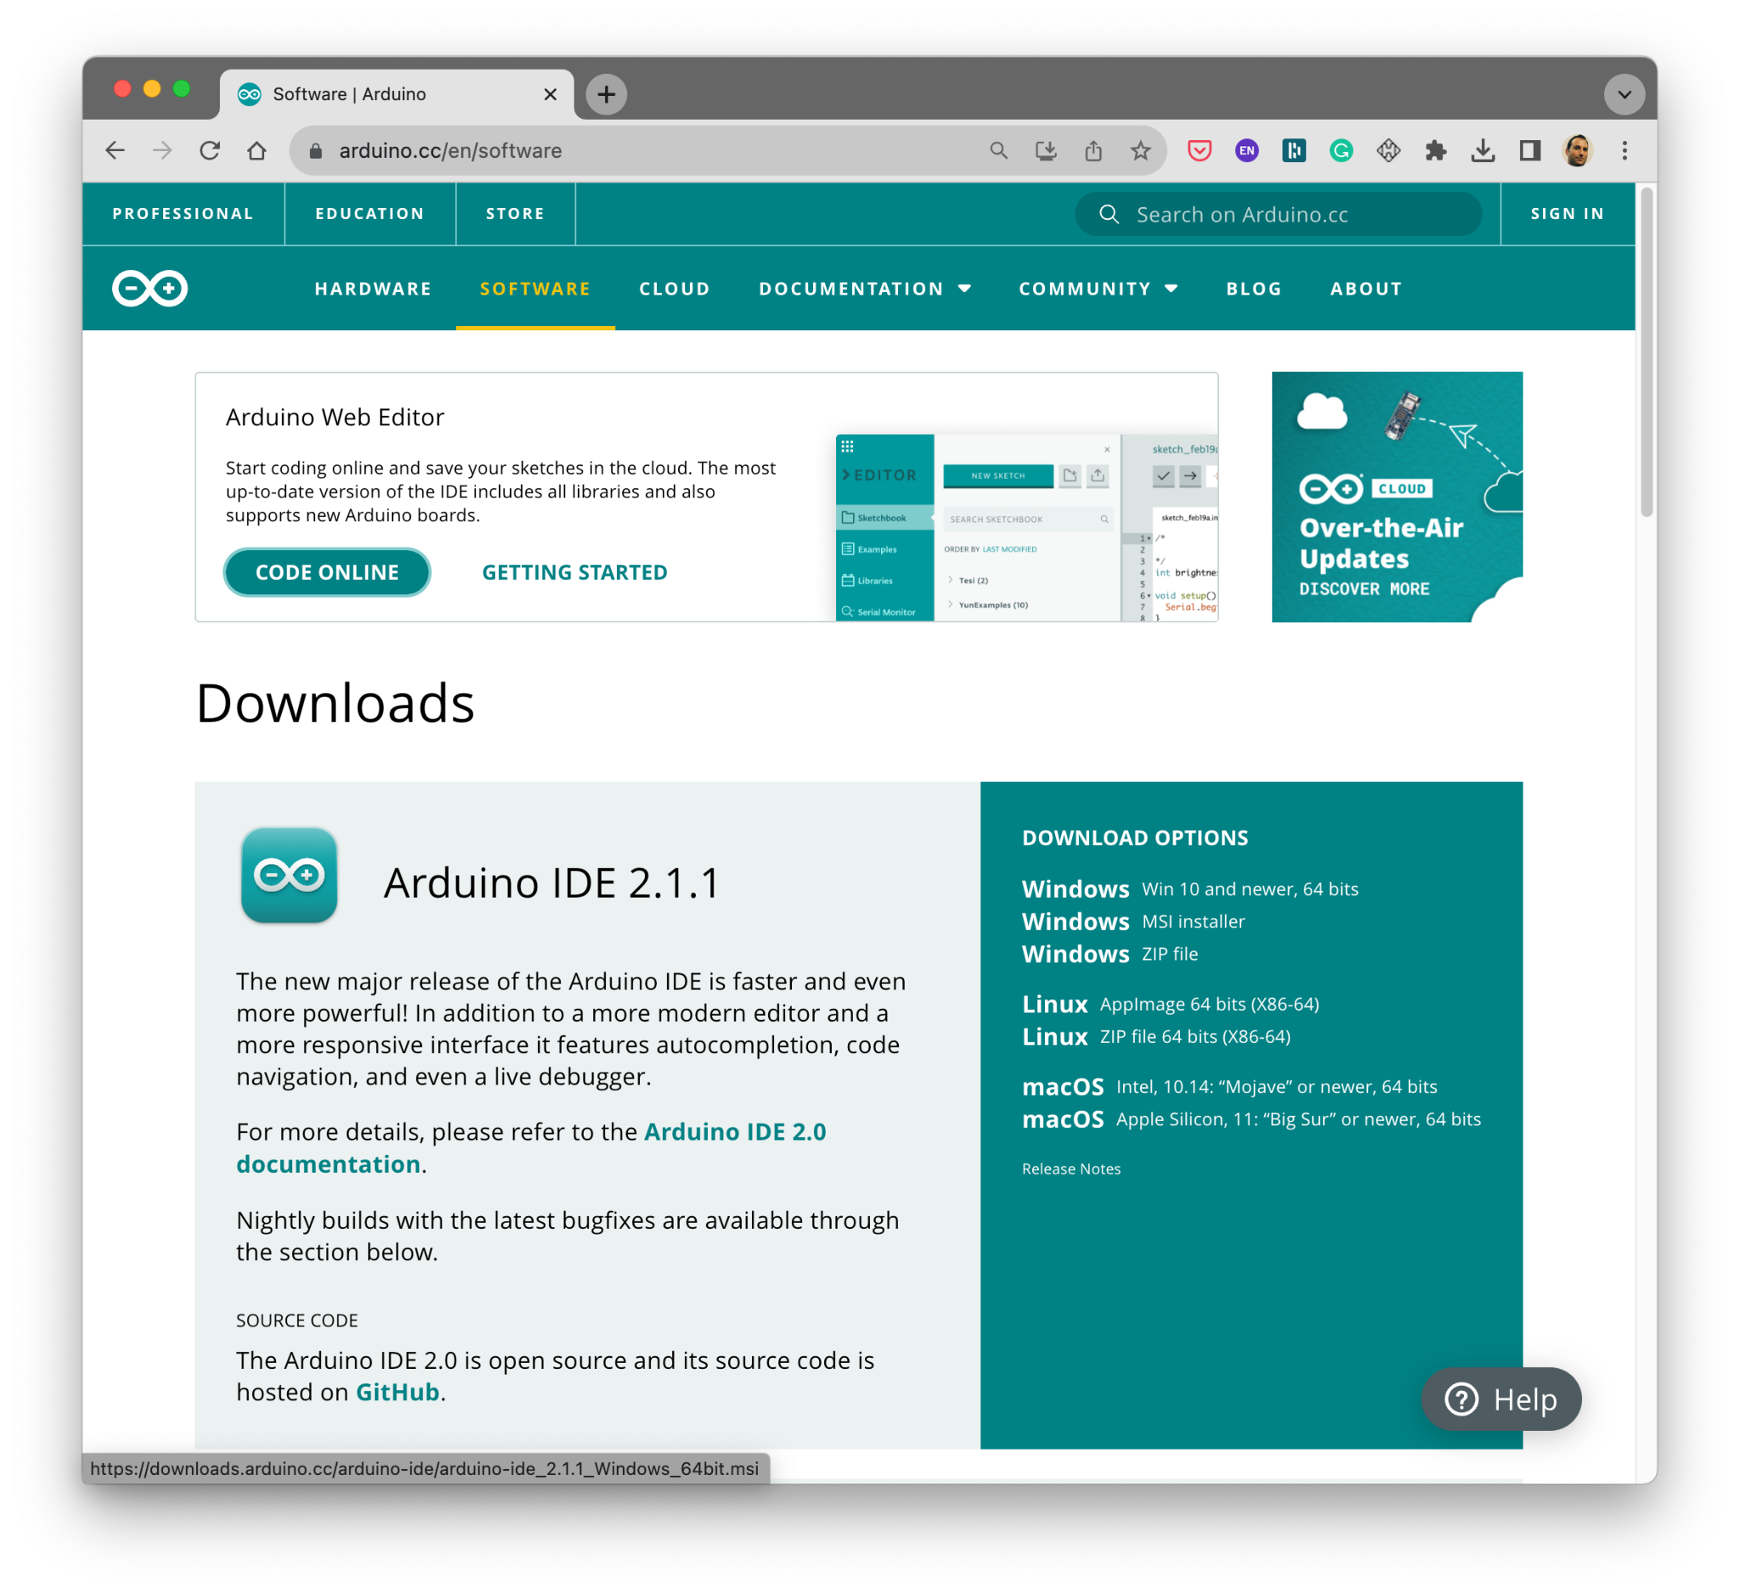
Use the IDE or Download the IDE
Use the Web Editor or IDE from: https://www.arduino.cc
First let’s blink
Library needed also (next slides)

Slide 13
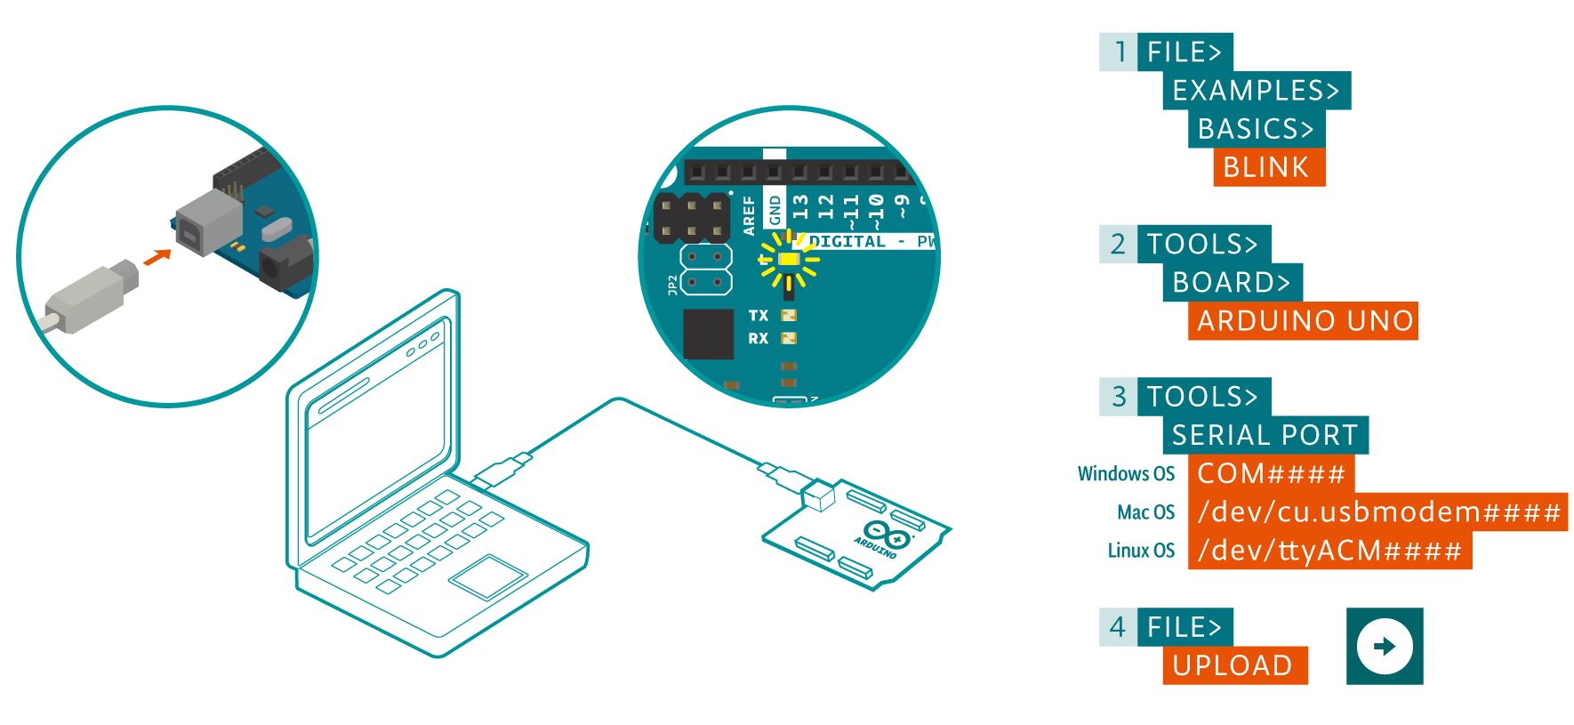
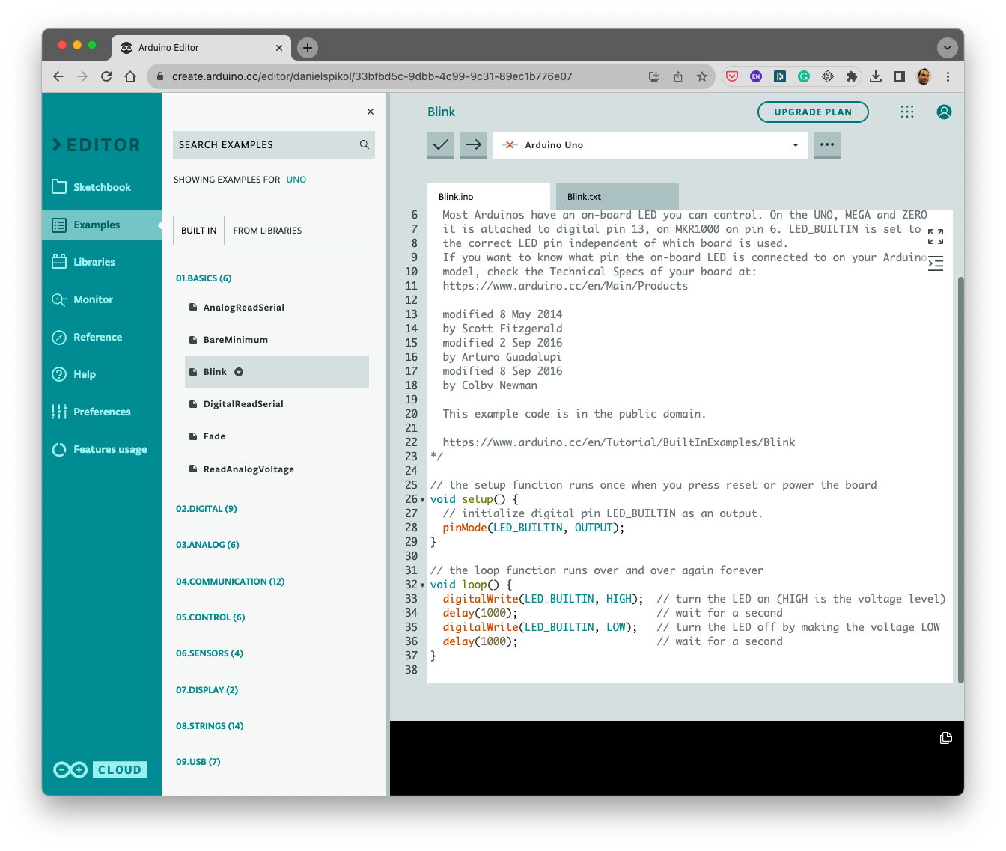
Getting the Program to the Arduino Board
Notes:
Windows: Plugin: Show where the driver is and install it.
OSX + Linux should work out fine.
When kids are done before others ask them to make the LED blink like a heart beat.
Slide 14: Explain what the breadboard is.
Normally you solder connections. But it’s a pain in the ass to do this all the time.
Breadboard is used to quickly test if things work before you actually produce it.
Explain the horizontal and vertical lines. And how power is distributed among them.
Tell them not to remove the sticker on the back of the breadboard

Slide 14
Arduino Web BLINK test

Slide 15
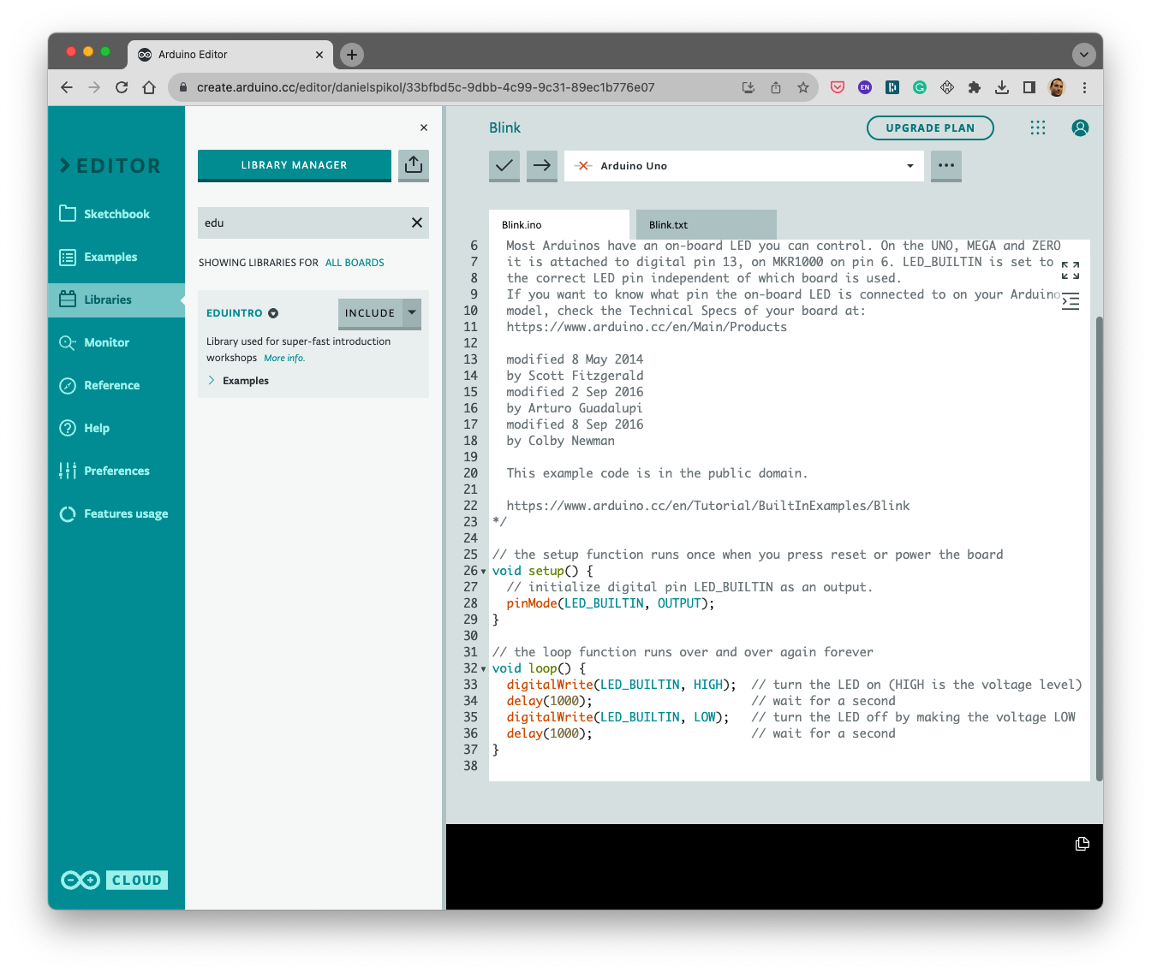
Arduino Web and EDUINTRO Library

Slide 16
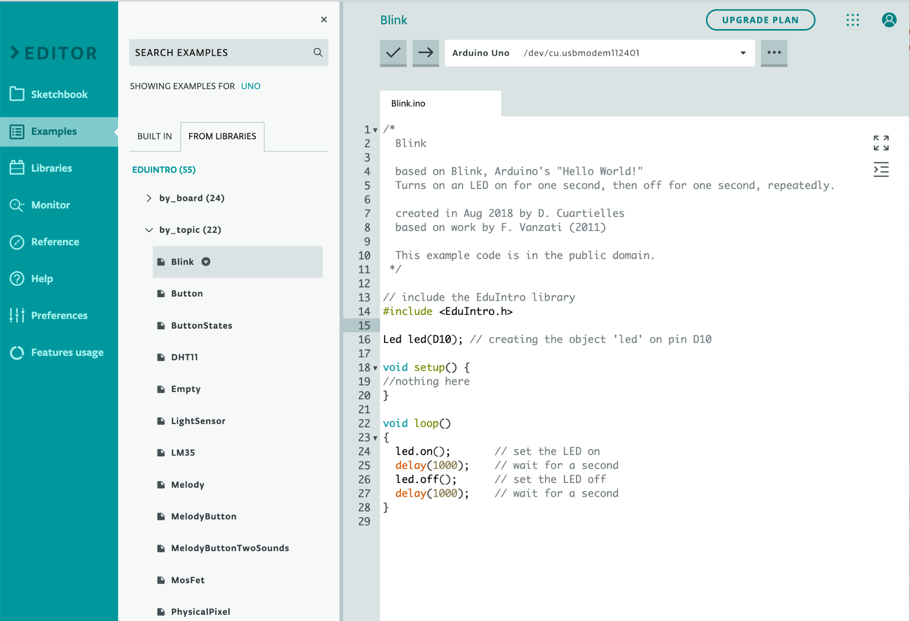
The IDE MENU
File Menu
Verify and Upload
Code Area
New, Save, Open, Examples...
Test your code Upload you code +
COM-Port Settings, Tools, Board Type...
Cut, Copy, Paste
Notes:
All Arduino programs are called sketches. Heritage from Processing environment. Processing was a sketchpad.
Tools menu: COM-port. Set the right port to use the USB port the Arduino is connected to.
Linux: TTY1 or TTY0
Windows: COM4 etc. next one COM5 (unique numbers)
OSX: TTY-USB Serial modem. Always the first one in the list.
Board type: Set correct model. (MICRO)
They have different kinds of firmware and bootloaders.

Slide 17
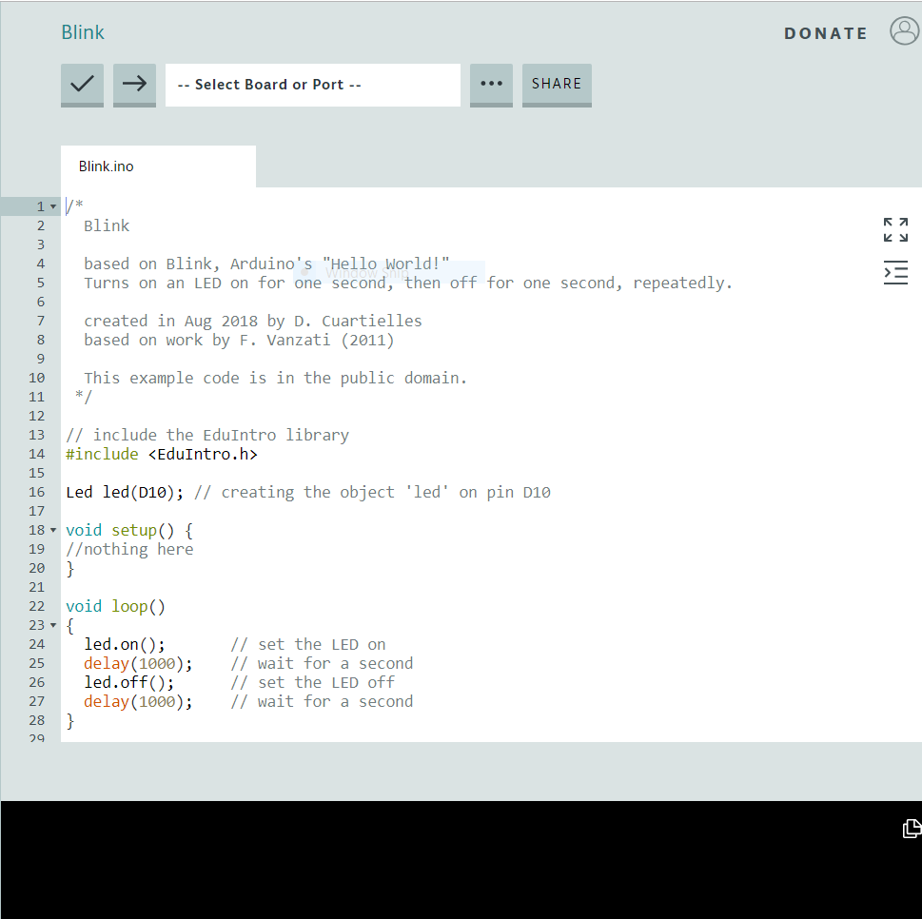
Program structure
Declarations
Set Up
Main Loop
Things the program needs to run. These include extra libraries and global variables and object
Setup the method is used to initiate the board before the code gets executed.
It executes from top to bottom, line by line, and then starts over (looping back).
Notes:
All Arduino programs are called sketches. Heritage from Processing environment. Processing was a sketchpad.
Tools menu: COM-port. Set the right port to use the USB port the Arduino is connected to.
Linux: TTY1 or TTY0
Windows: COM4 etc. next one COM5 (unique numbers)
OSX: TTY-USB Serial modem. Always the first one in the list.
Board type: Set correct model. (MICRO)
They have different kinds of firmware and bootloaders.

Slide 18
A bit about the Arduino Language
C/C++ Based:
The Arduino programming language is based on C/C++, which means it shares many of the same syntax rules, data types, and operators.
Setup and Loop Structure:
Programs usually contain a void setup() and void loop() function. setup() runs once for initial settings, while loop() runs indefinitely.
Case Sensitivity:
Arduino code is case-sensitive. For instance, Pin and pin would be treated as different variables.
Semicolons and Braces:
Statements must be terminated with semicolons, and code blocks are encapsulated within curly braces {}.
Comments and Whitespace:
Comments can be made with // for single-line comments or /* */ for multi-line comments. Whitespace is mostly ignored by the compiler but is useful for readability.

Slide 19
Code Structure
Includes & Variables
#Include is used to include outside libraries in your sketch. This gives the programmer access to a large group of extra C libraries (groups of pre-made functions). We will use the EDUINTRO Library this week
Variables are containers for values.
You can give a variable any name you like.
The value of a variable can be changed and used dynamically as many times as you like.
Notes:
Talk about programming languages:
Compile into machine code, 0’s and 1’s
Arduino syntax is a mix of C and C#.
It’s a third level language.
Uploading: the process of taking the code and putting it on the arduino board.
The code stays there until new code is uploaded.

Slide 20
Code Structure
The Setup Method
Setup the method is used to initiate the board before the code gets executed.
This code runs only once when the reset button has been pressed.
It defines if pins should be used as inputs or outputs, whether serial communication is going to be used, etc.
Notes:
2: Setup.
In every program you write there have to be two functions: Setup and Loop
Setup kicks off a program.
For instance declare which pins you will use.
From the start Arduino doesn’t know how you want to use them, you have to tell it.
It has to know where to direct power to or on which pin to listen for information.
The setup only runs once.
The arduino runs code line by line, this is why semicolons are used.

Slide 21
Code Structure
The Program Loop
The loop is where the action is!
This is where you write your program
It executes from top to bottom, line by line, and then starts over (looping back).
Notes:
Talk about programming languages:
Compile into machine code, 0’s and 1’s
Arduino syntax is a mix of C and C#.
It’s a third level language.
Uploading: the process of taking the code and putting it on the arduino board.
The code stays there until new code is uploaded.

Slide 22
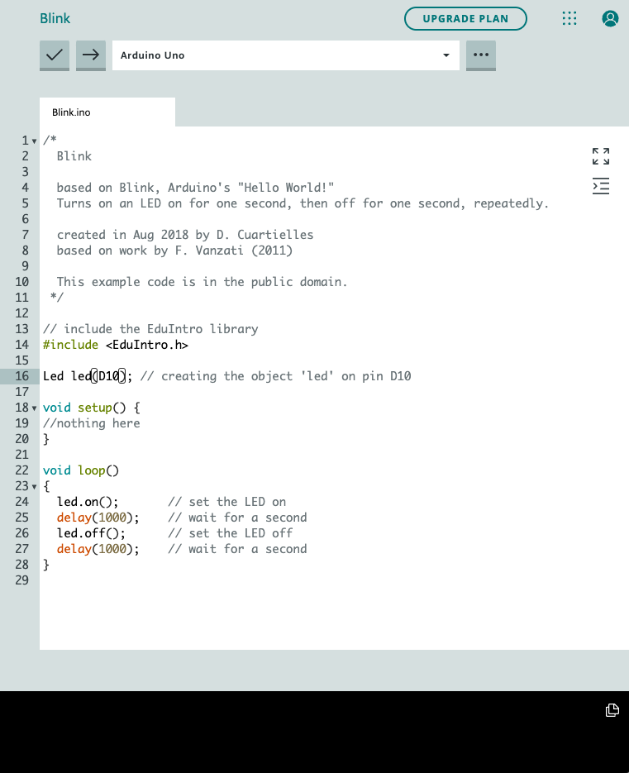
Take a look and CHANGE BLINK
EDUINTRO Examples BLINK

Slide 23
Let’s add an Output - LED

Slide 24
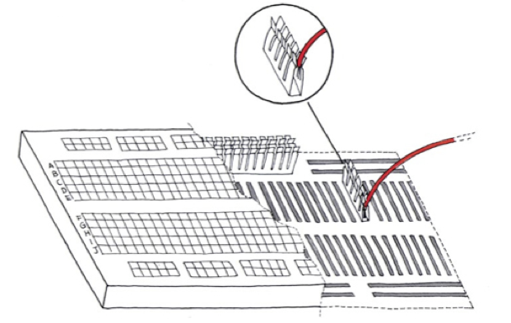
Breadboards
Image taken from booklet by M. Banzi et al.

Slide 25
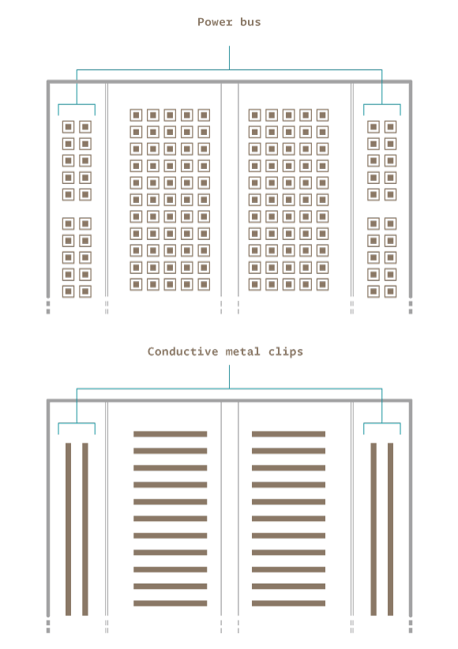
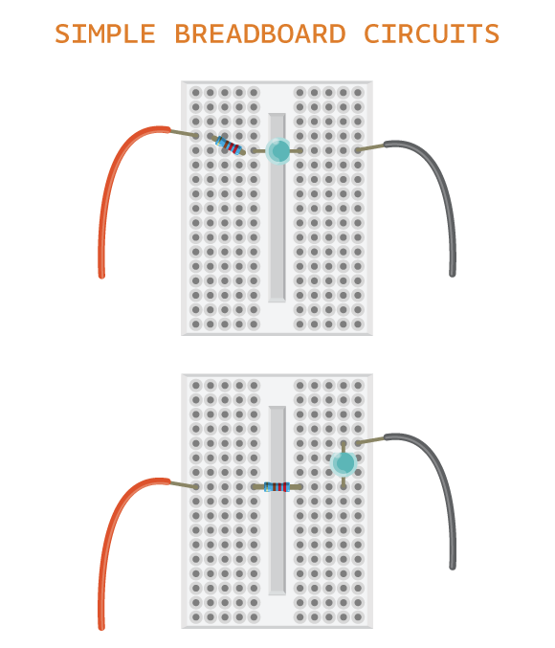
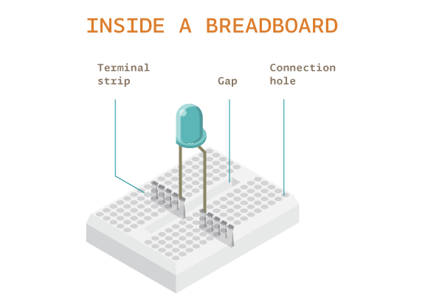
More about Breadboards
Notes:
When you do push the button you open up a connection to ground. Electricity always takes the easiest route back to the power source. Ground is easier than the other connection.
Write the code as a live coding session

Slide 26
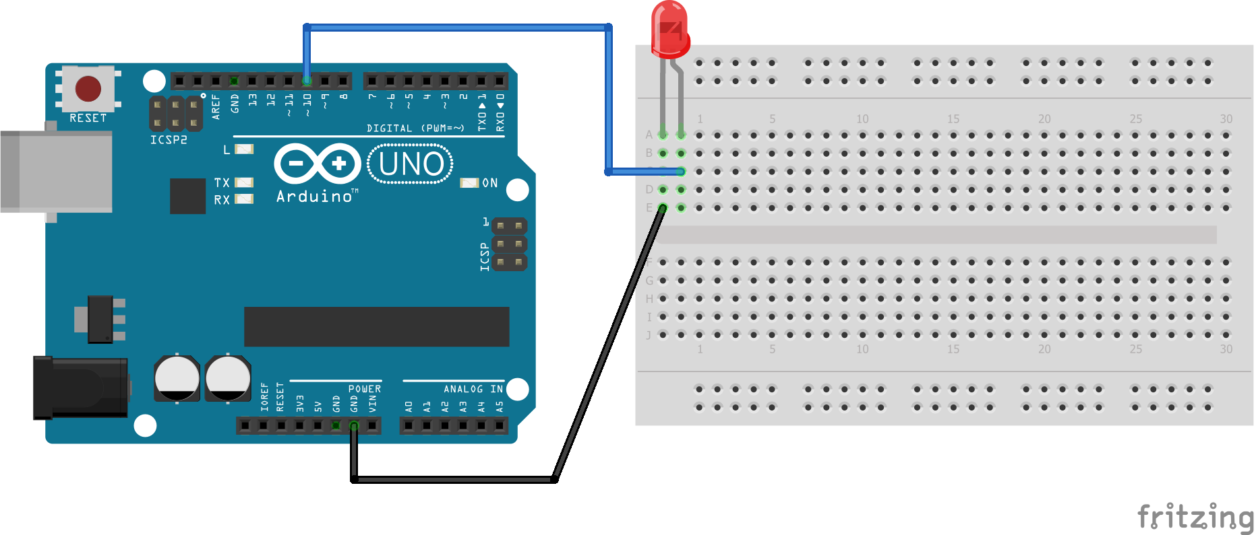
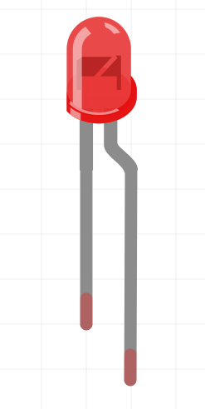
Wire up the LED
Long side of LED is +positive
EDUINTRO Examples BLINK

Slide 27
Take a look and CHANGE BLINK
EDUINTRO Examples BLINK

Slide 28
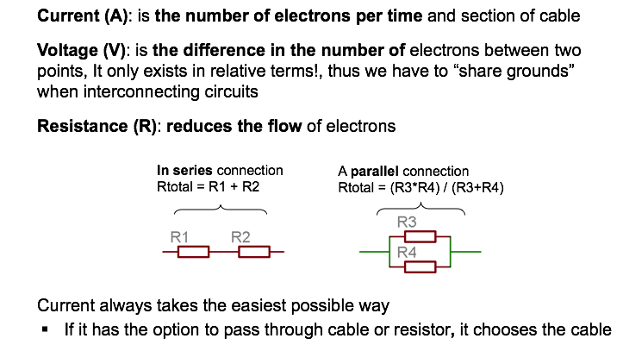
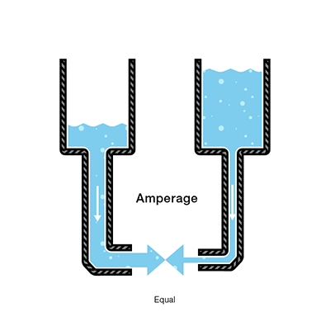
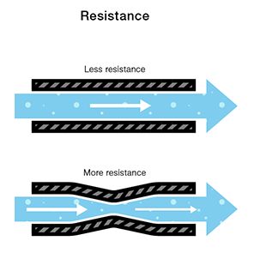
Resistors
Notes:
The resistor is the part of an electrical circuit that resists, or limits, the power of an electrical current in a circuit. The resistor also helps to reduce, or lessen, the amount of electricity moving through the circuit. Resistor for an Electrical Circuit Resistor for an Electrical Circuit Resistors are important to circuits because they reduce the amount of electricity traveling by a current through the circuit. This ensures that the right amount of electricity is provided to an object that needs electricity to work
Tell them about current voltage and resistance.
Explain the water analogy.
Electricity works as water.
When you push it through a garden hose the hose acts as resistance.
Same as a wire, it reduces the amount of electrons transfers.
Voltage is the speed of the water and the electricity.
When you try to put too much water through the hose it will burst.
Same goes for electricity.
Important: Ground. Power always has to go back to the source it came from. This is ground.

Slide 29
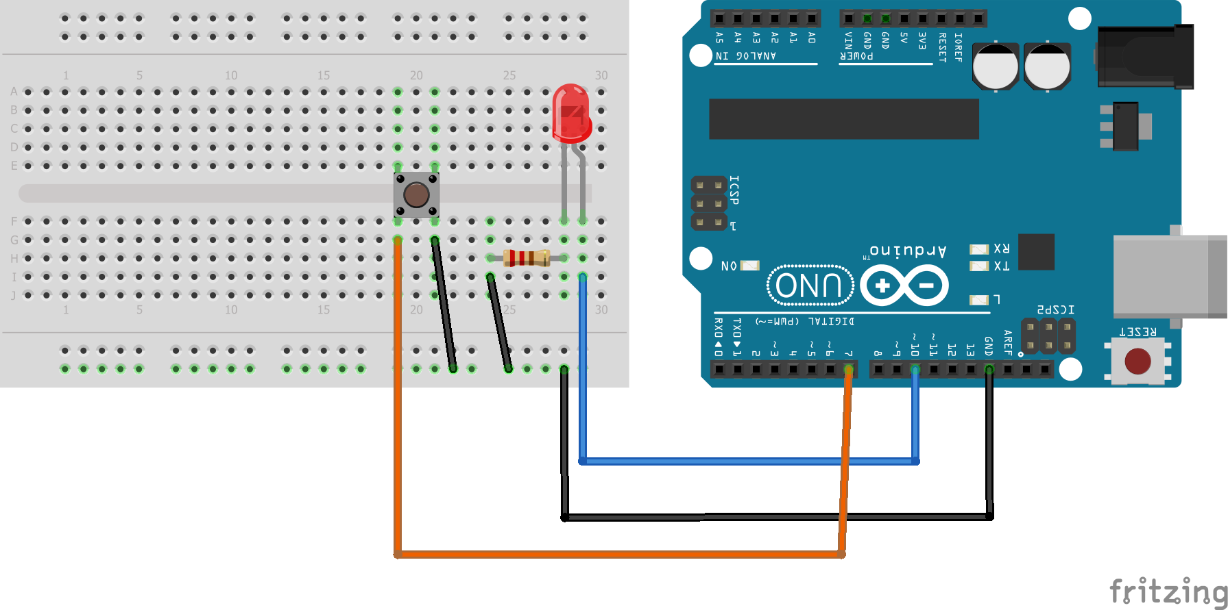
Now add Button for the LED
Long side of LED is +positive
Code EDUINTRO Button

Slide 30
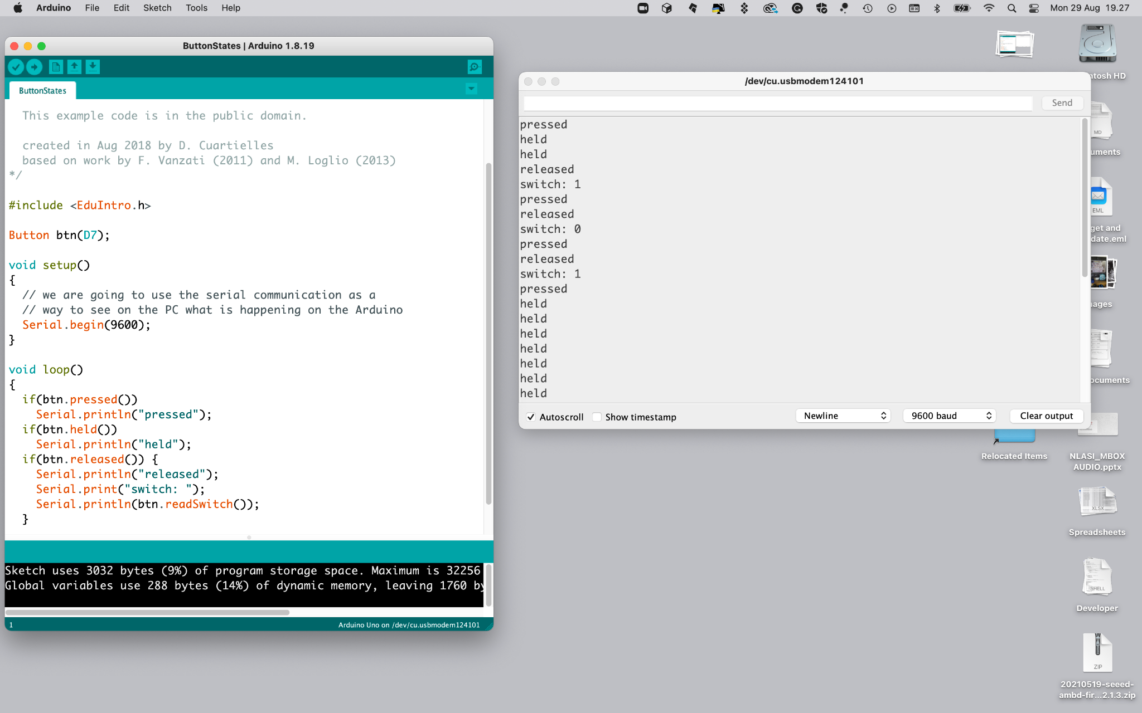
More about Buttons
Code EDUINTRO Button

Slide 31
Arduino Cards

Slide 32
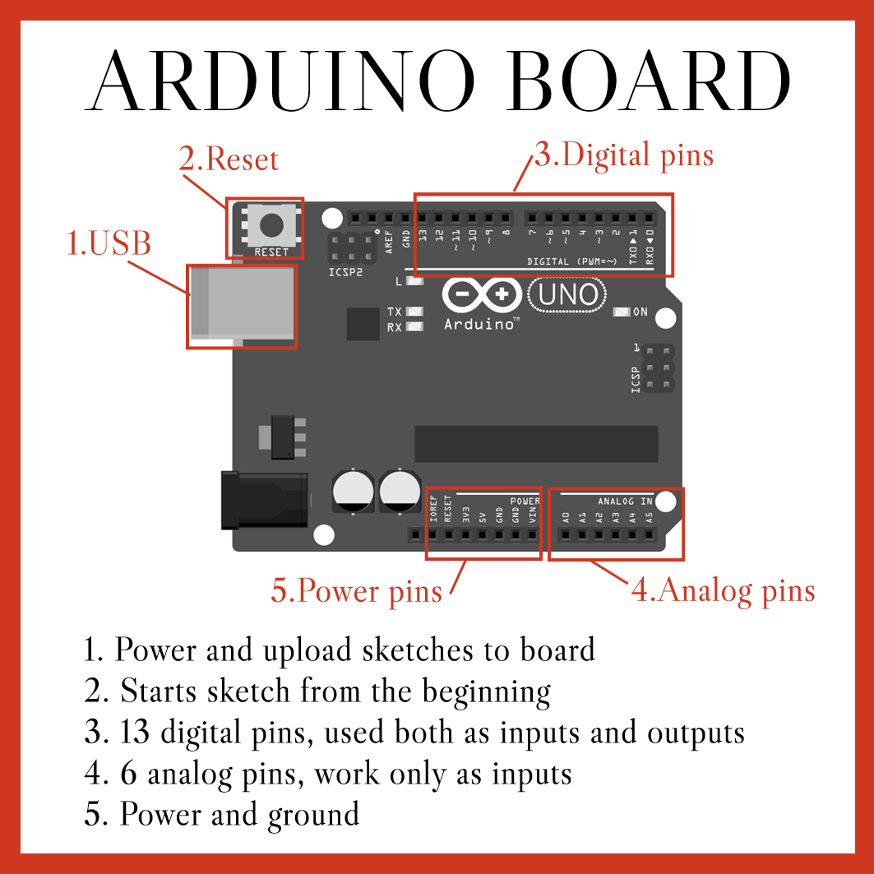
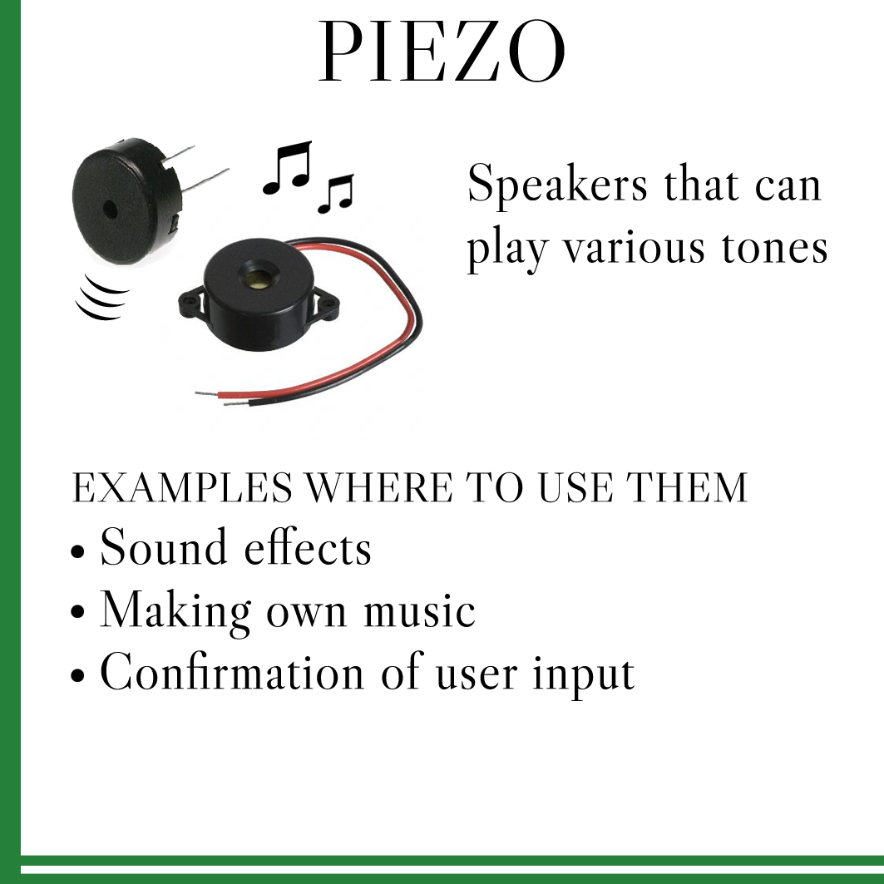
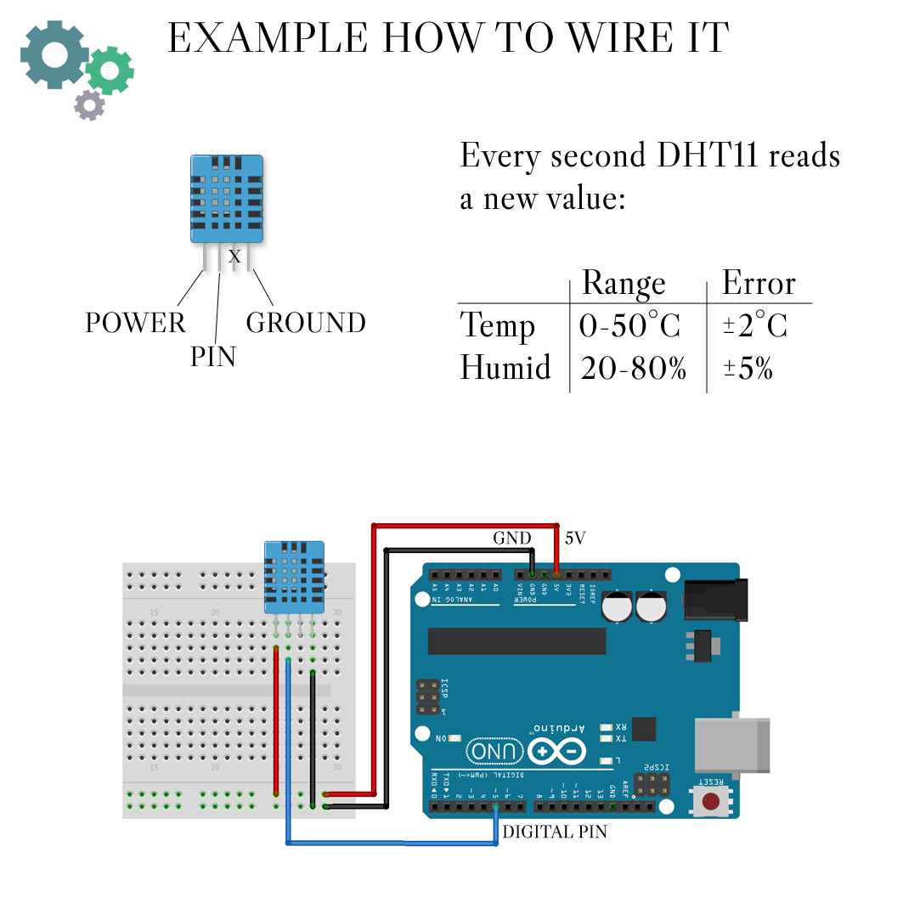

Slide 33
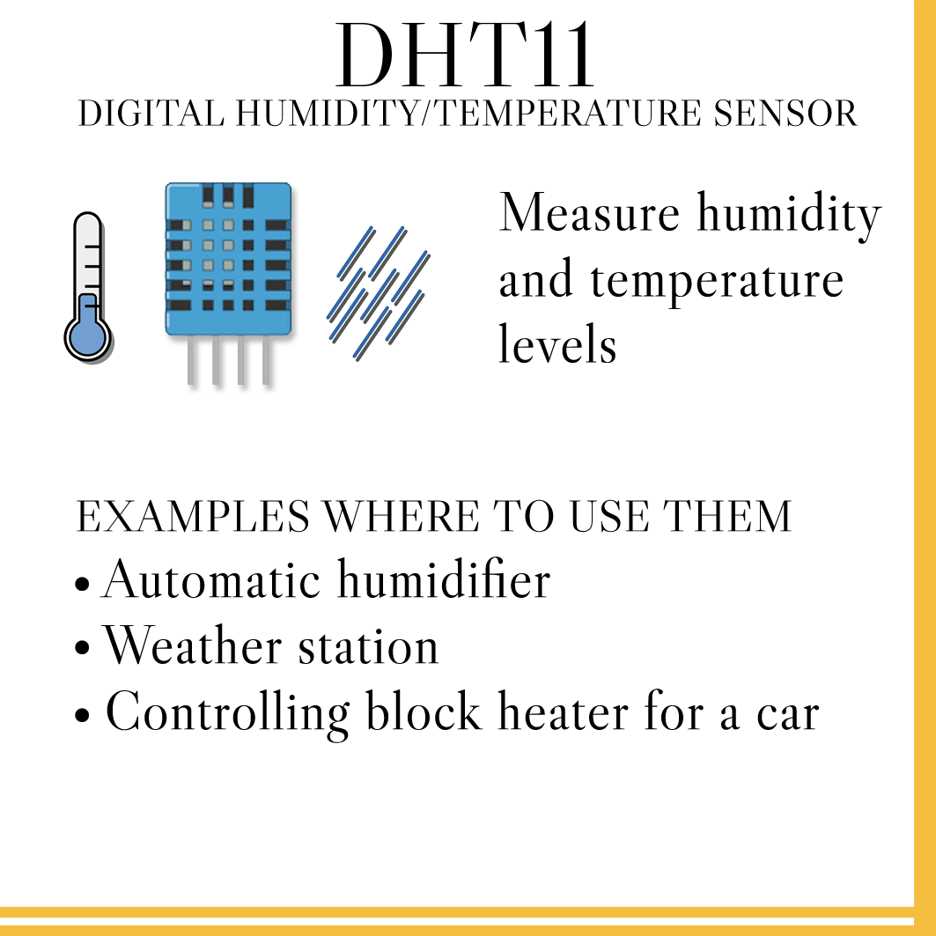
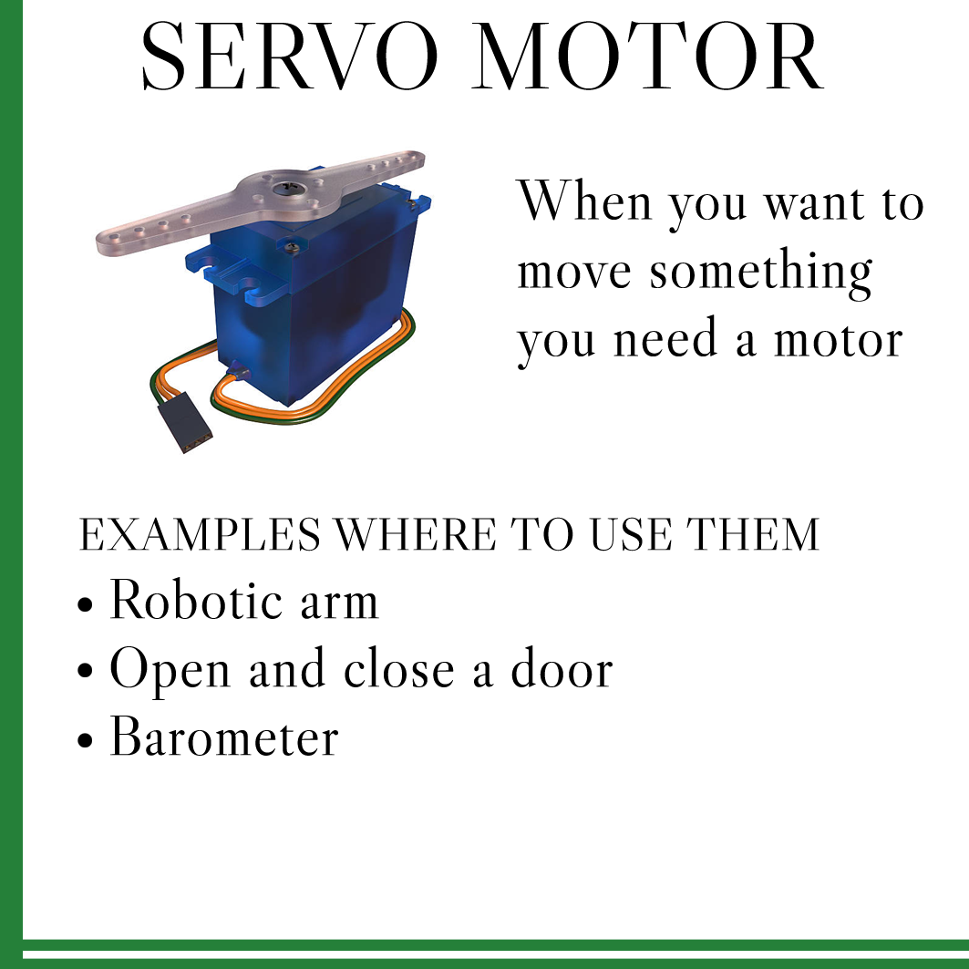
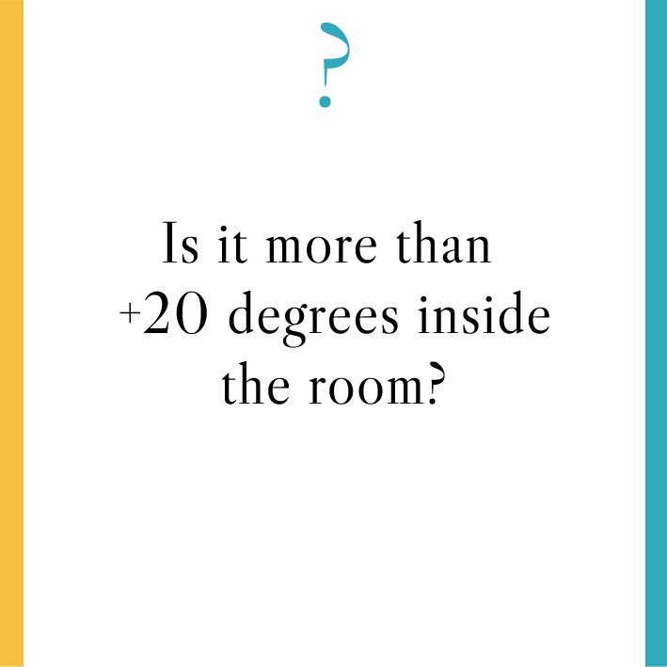


Slide 34
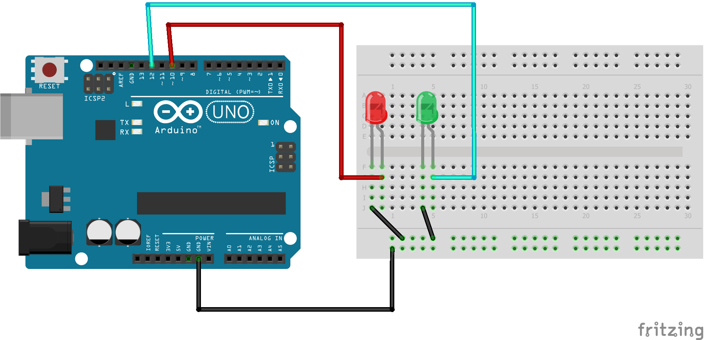
Double the fun & the code!

Slide 35
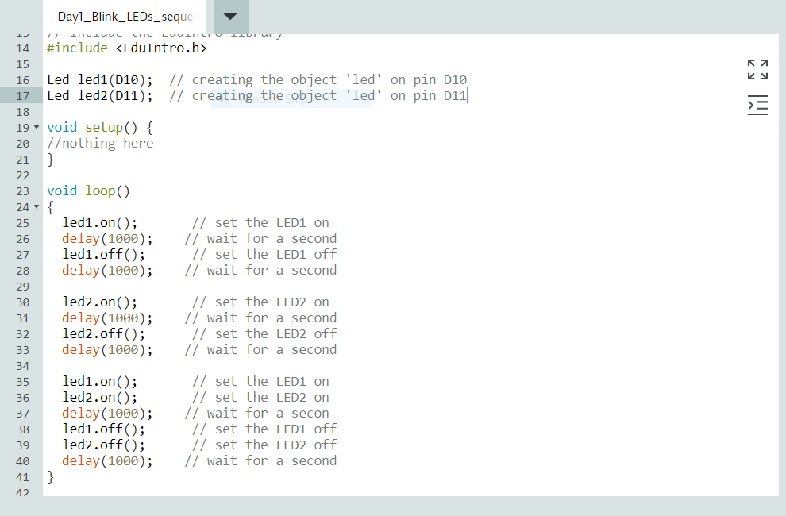
Double the fun & the code!
New LED object
At D11
Copy, Paste, and play around!

Slide 36
Button States and different LEDs
If … then

Slide 37
More about Buttons and Serial Monitor
Code EDUINTRO ButtonState

Slide 38
PIEZO “Pump up the Volume”

Slide 39
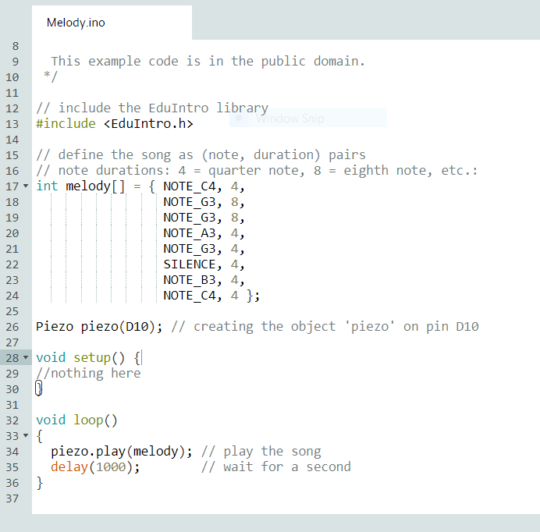
Basic Piezo Concepts
Array variables see ln 17 int melody[] = { NOTE_C4, 4, NOTE_G3, 8, NOTE_G3, 8, NOTE_A3, 4, NOTE_G3, 4, SILENCE, 4, NOTE_B3, 4, NOTE_C4, 4 };
Notes:
In computer science, an array data structure, or simply an array, is a data structure consisting of a collection of elements, each identified by at least one array index or key. An array is stored such that the position of each element can be computed from its index tuple by a mathematical formula

Slide 40
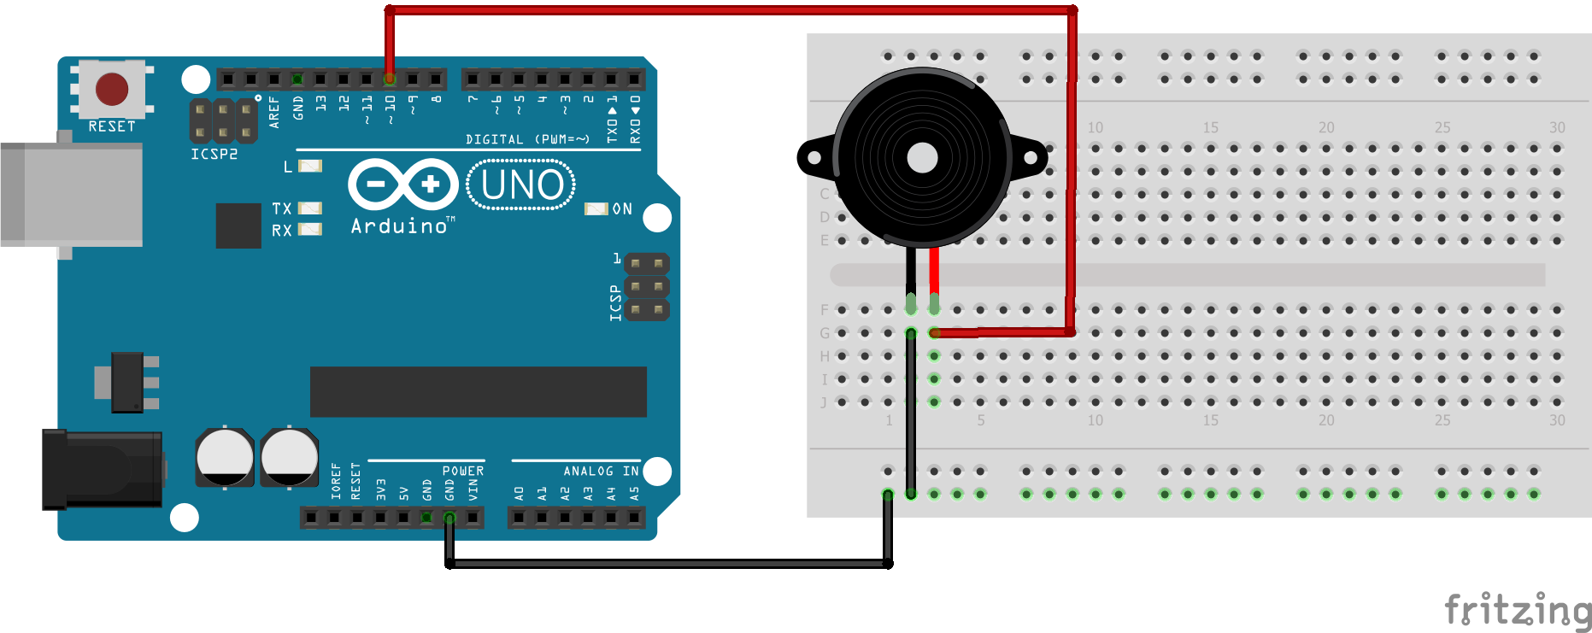
Piezo Concepts

Slide 41
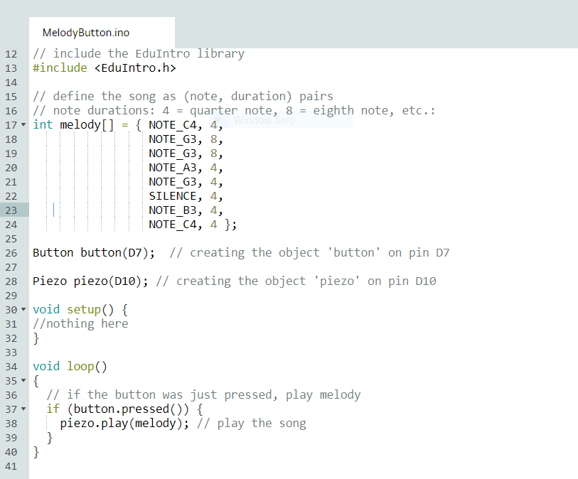
Piezo and Button
Concepts
Array
Conditional Statements
EduIntro >>courseware>>workshop_1h >> MelodyButton

Slide 42
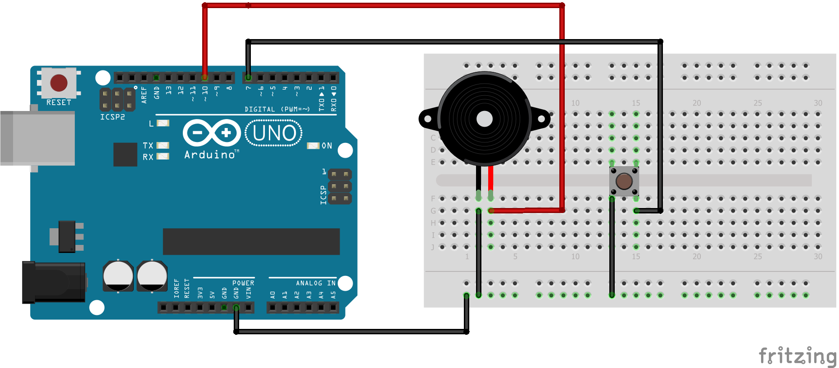
Piezo and the Button

Slide 43
Servo Motors

Slide 44
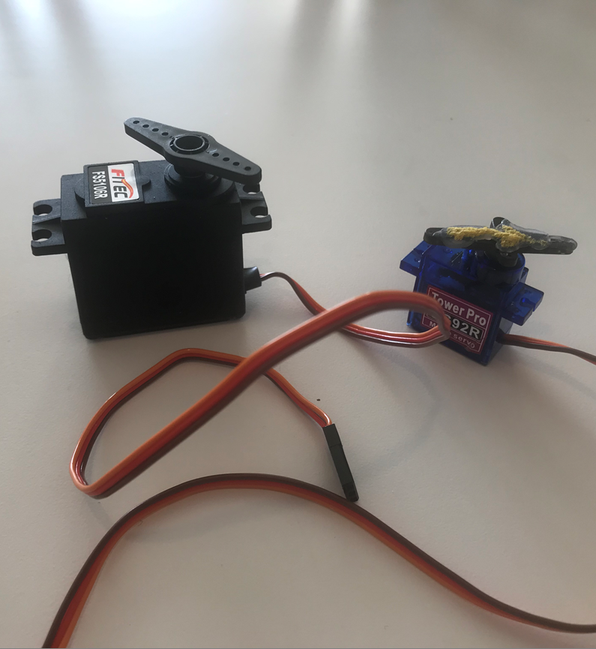
Servo Motors
Small = 180 direction
Big = continuous
Brown=ground
Red = 5V
Yell = signal

Slide 45
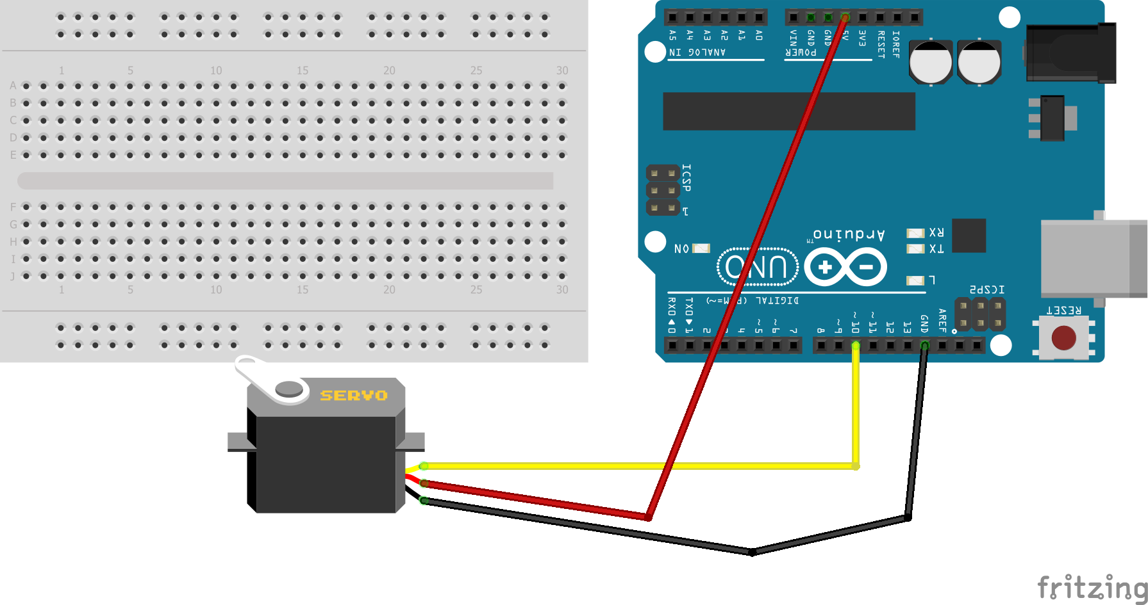
180 Sweep
Ingredients
180 Servo
Cooking
EduIntro >>coursware>>workshop_1h>>Servo

Slide 46
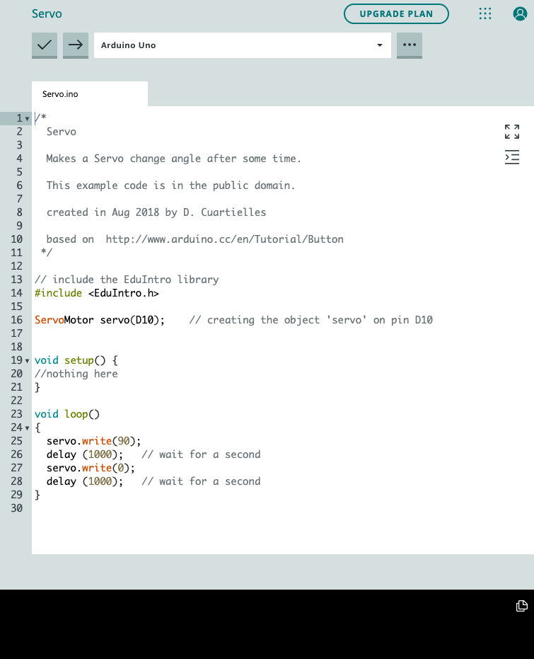
180 Sweep
Ingredients
180 Servo
Cooking
EduIntro >>coursware>>workshop_1h>>Servo

Slide 47
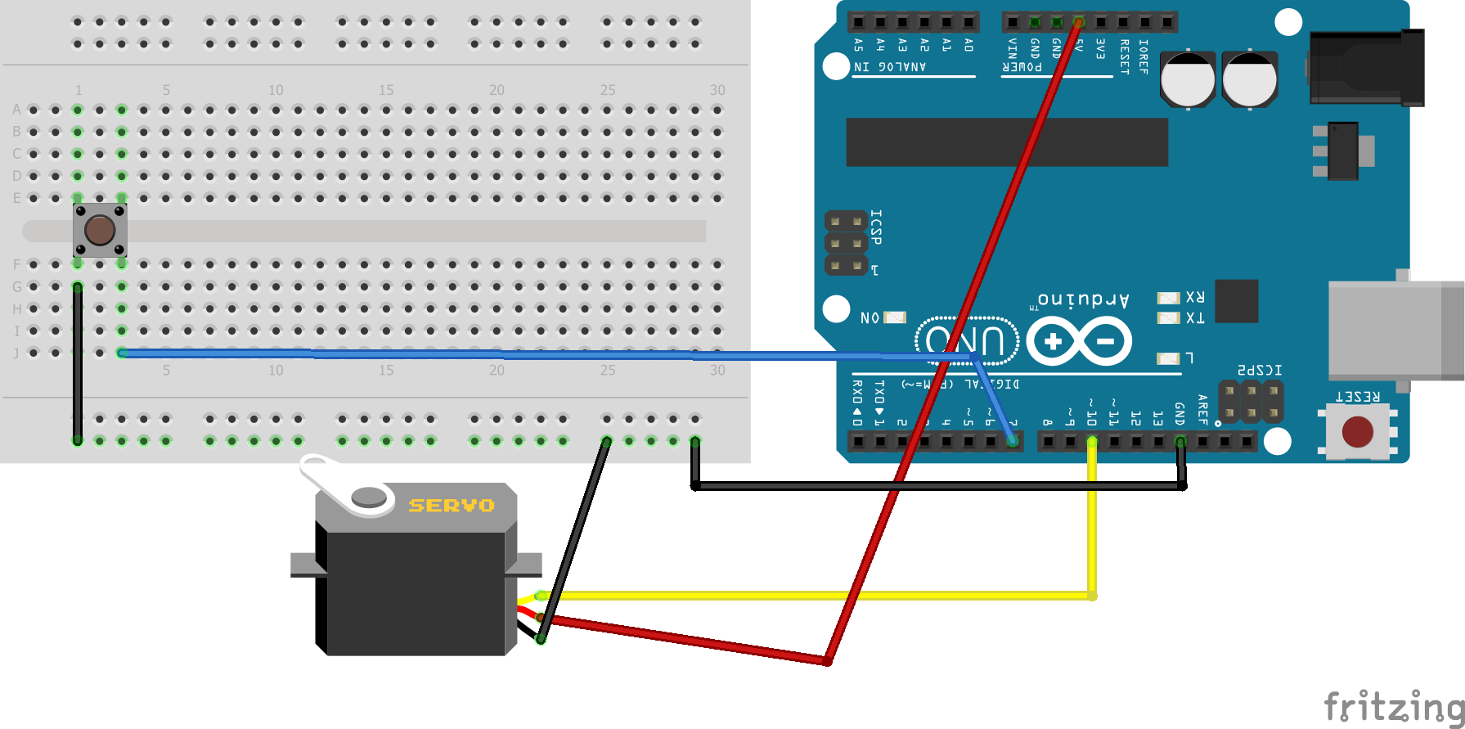
180 Button
Ingredients
180 Servo
Button
Cooking
EduIntro >>coursware>>workshop_1h>>ServoButton

Slide 48
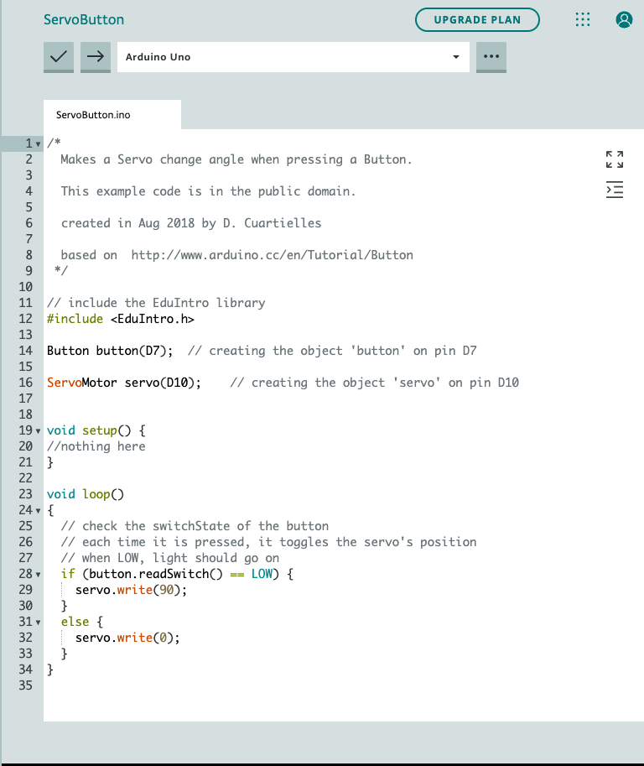
180 Button
Ingredients
180 Servo
Button
Cooking
EduIntro >>coursware>>workshop_1h>>ServoButton

Slide 49
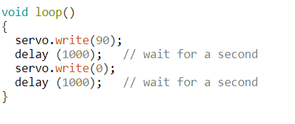
180 Button
Concept
Explore what happens when you switch the value to 180 and other values even 200
Cooking
EduIntro >>coursware>>workshop_1h>>ServoButton

Slide 50
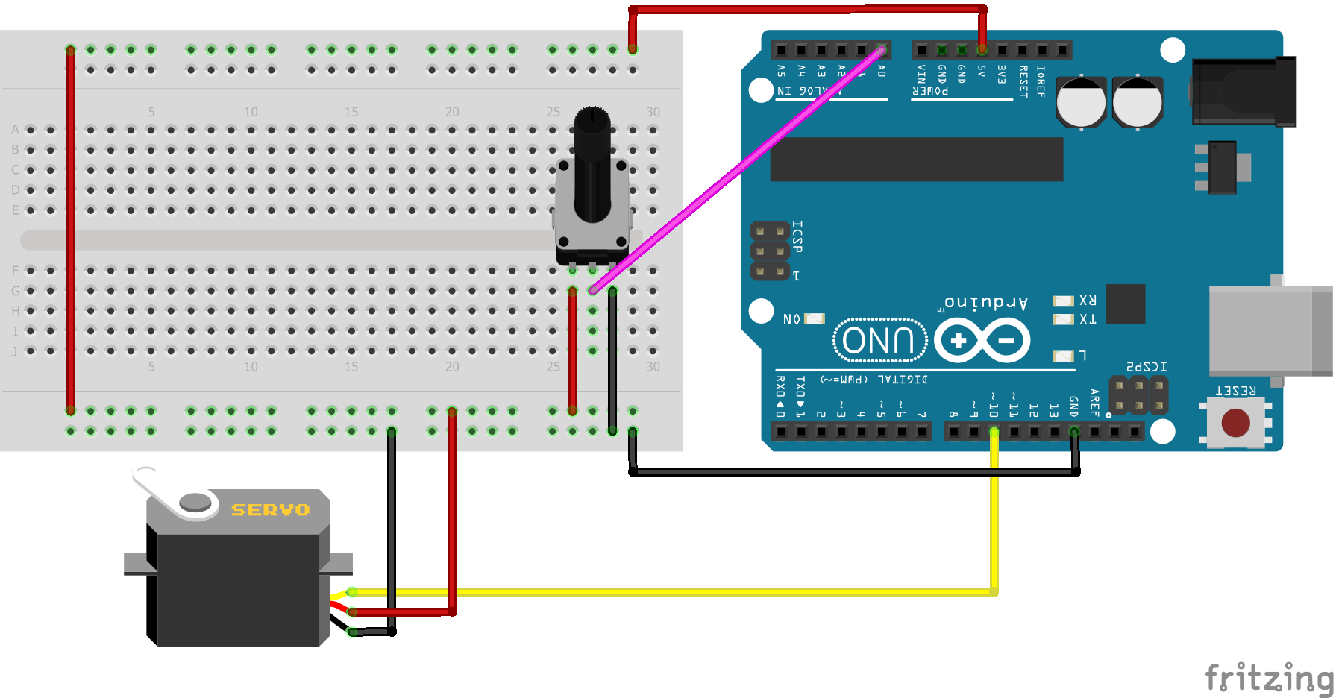
Continuous Motot Potentiometer
Ingredients
Big Servo Motor
Potentiometer
Cooking
EduIntro >>by_topic>> ServoKnobContinuous

Slide 51
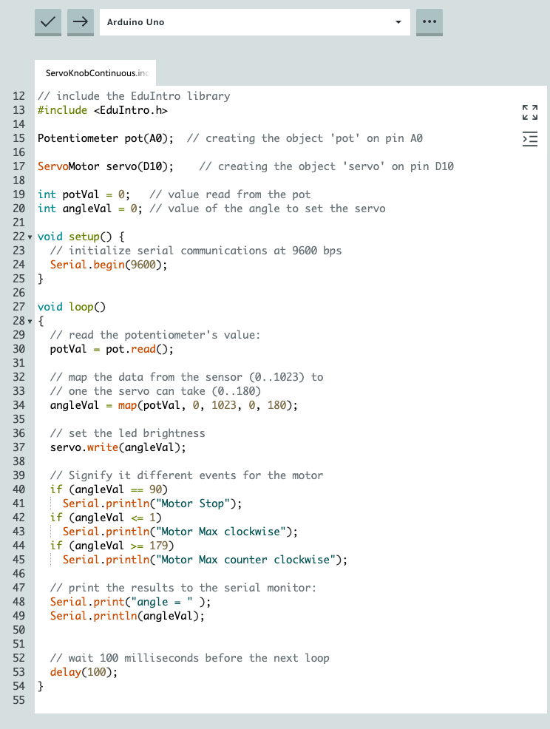
Continuous Motot Potentiometer
Concepts
Continuous motors
90 is stop
0-89 clockwise with speed
91-179 counterclockwise with speed

Slide 52
Digital Humidity and Temperature
DHT11 Sensor

Slide 53
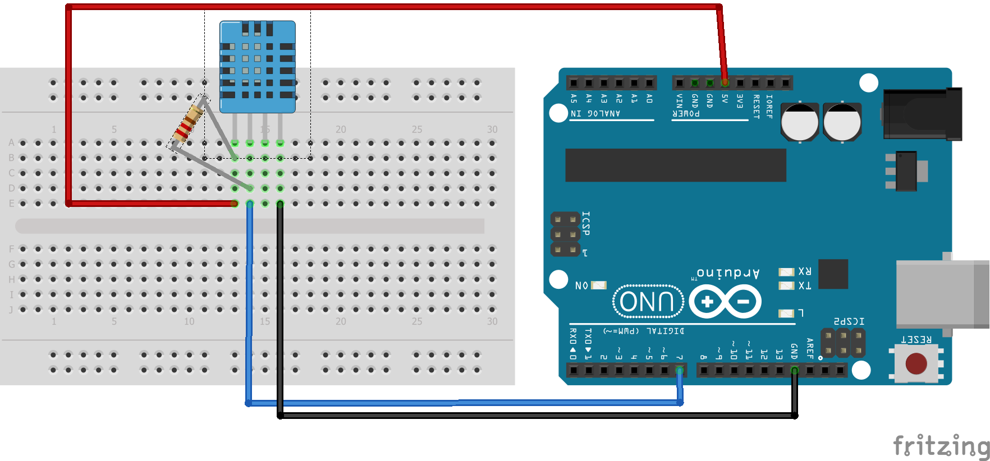
DHT11
Cooking
DHT11 Sensor
Resistor (in bag)
Between 5V and Signal
Ingredients
EDUINTRO>>by_topic>>DHT11

Slide 54
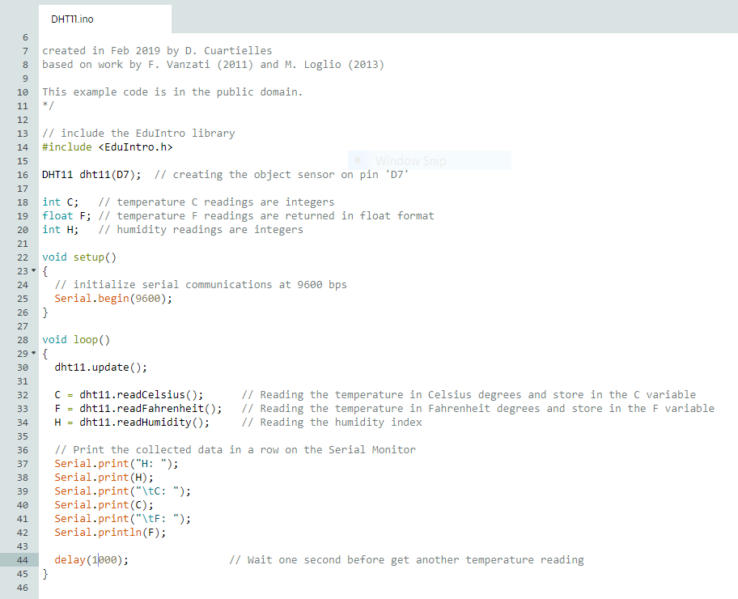
DHT11
Float variable
Datatype for floating-point numbers, a number that has a decimal point. Floating-point numbers are often used to approximate analog and continuous values because they have greater resolution than integers.

Slide 55
DHT11
PIR= 5V, GND, D2
LED, 5V, GND, D12
Piezo GND, D3
Code:
In Piezo 1C

Slide 56
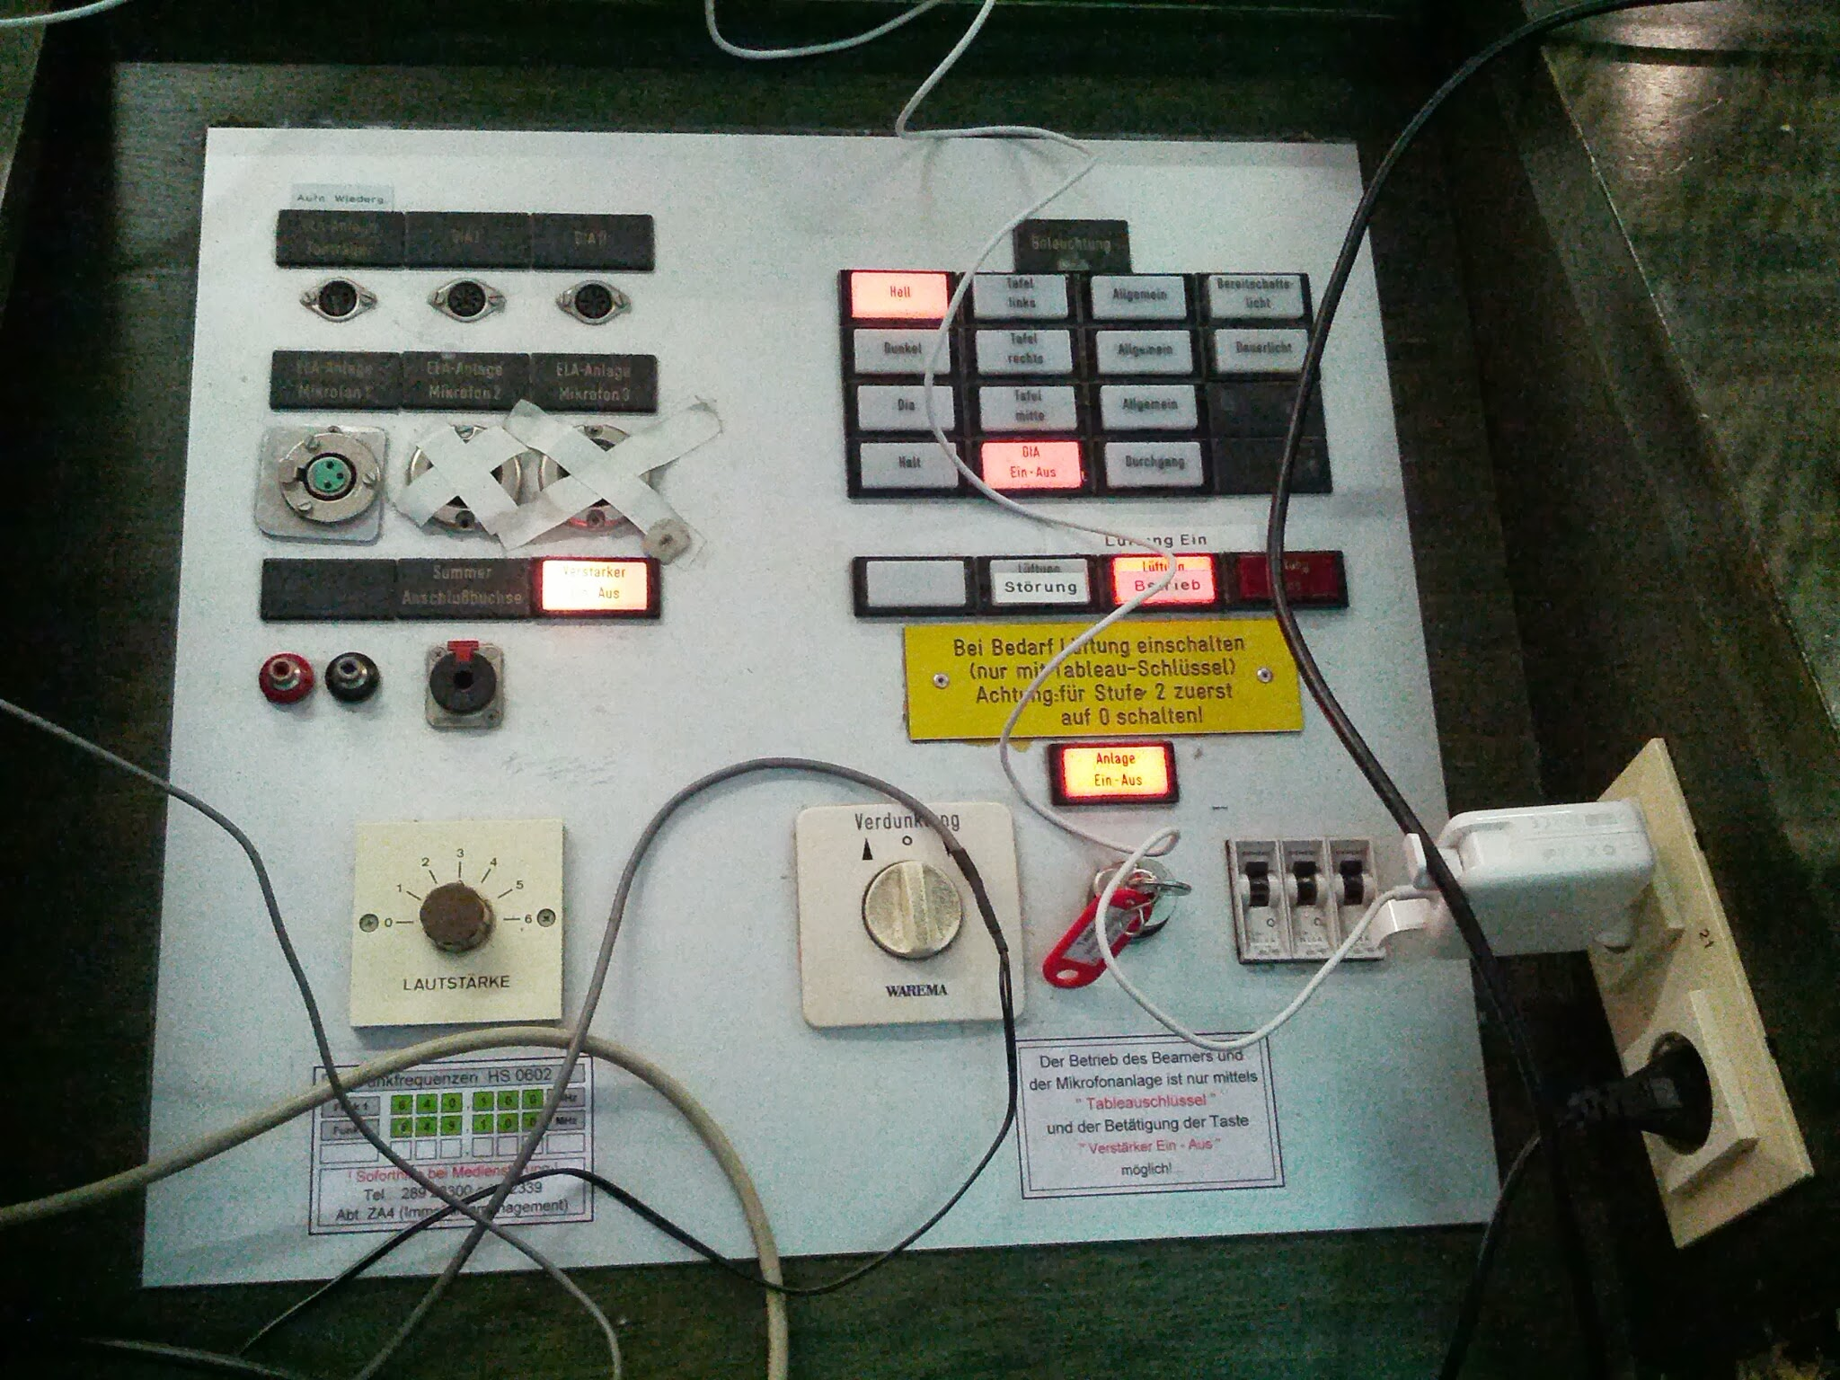


Putting it together

Slide 57
Building complex programs
Think input - What will be the trigger, the interaction.
How am I going to Output?
The Brain between the senses is the Arduino board
Think Control Structures
If then and Else if…
Other ways see Switch Case (reference)
Remember LOOP goes on and on until the end
Use the Serial Monitor to check things…

Slide 58
Complexity
For some sensors using the map() function can be good
You may need to use If then Else if to build structure to your project
Consider how to adjust your ideas to convey the concept rather than being locked into a single way…

Slide 59

Structure Sketch

Slide 60

Hackathon Mission

Slide 61
Your mission today:
Requirements for the toy
Target group should be kids, elderly people, chronically ill, or pets
At least one input (kit includes: buttons, light sensor, humidity/temperature sensor)
At least one output (kit includes LEDs, speaker, motor)
Notes:
900

Slide 62
Your Resources:
Each other, TAs, Mentors, and me
Arduino and hardware
Arduino Learning Cards that will help you to program, wire and design the toy
Arduino Kit
Crafting materials to decorate your toy such as glue gun, paper, pens, etc.
Notes:
900

Slide 63
Brainstorm in teams of circa 3
Coder, Electronics, and Designer (your team roles)
Quickly 5 minutes brainstorm individually - as many ideas as possible
Now evaluate the ideas and choose 1 or 2 as a team
Sketch out your ideas with the cards
Make a plan
Build!
Notes:
900

Slide 64
Extra goodies

Slide 65

More about Buttons & Serial Monitor

Slide 66

More about Buttons & Serial Monitor

Slide 67
Light Dependent Resistors
Notes:
A photoresistor (or light-dependent resistor, LDR, or photo-conductive cell) is a light-controlled variable resistor. The resistance of a photoresistor decreases with increasing incident light intensity; in other words, it exhibits photoconductivity. A photoresistor can be applied in light-sensitive detector circuits, and light-activated and dark-activated switching circuits.
A photoresistor is made of a high resistance semiconductor. In the dark, a photoresistor can have a resistance as high as several megohms (MΩ), while in the light, a photoresistor can have a resistance as low as a few hundred ohms. If incident light on a photoresistor exceeds a certain frequency, photons absorbed by the semiconductor give bound electrons enough energy to jump into the conduction band. The resulting free electrons (and their hole partners) conduct electricity, thereby lowering resistance. The resistance range and sensitivity of a photoresistor can substantially differ among dissimilar devices. Moreover, unique photoresistors may react substantially differently to photons within certain wavelength bands.

Slide 68

Use the LDR to control the LED
Ingredients
LED
200 Ohm resistor
LDR (Big)
1M Ohm resistor (blue)
Cooking
EDUINTRO >> by_topic >> LightSensor

Slide 69
Use the LDR to control the LED

Slide 70

Concepts for the LDR to control the LED
Concepts
experiment with ln 33 //led.brightness(1023 - brightnessVal); see what happens when you uncomment that.
notice that the LDR sensor is analogue and requires 5 volts
see that we use the setup() to start the Serial.Monitor
Concepts
Go a step further by adding a if.. then statement with the variable brightnessVal
See and example of things at https://create.arduino.cc/editor/danielspikol/fb3f8366-c4f9-4559-8331-9d07eb9e28eb/preview

Slide 71
Programming
int Variable
Description
Integers are your primary data-type for number storage.
Syntax
int var = val;
var - your int variable name
val - the value you assign to that variable
See https://www.arduino.cc/reference/en/language/variables/data-types/int/

Slide 72

180 Potentiometer
Concepts
Need to declare the Potentiometer (Ln 14)
Need to read the value (Ln28)
Map() function
Re-maps a number from one range to another. That is, a value of fromLow would get mapped to toLow, a value of fromHigh to toHigh, values in-between to values in-between, etc.
https://www.arduino.cc/reference/en/language/functions/math/map/
Use of local variable “angleVal” (ln 32)

Slide 73
Pryoelectric Infrared Sensors
Notes:
A passive infrared sensor (PIR sensor) is an electronics sensor that measures infrared (IR) light radiating from objects in its field of view. They are most often used in PIR-based motion detectors.

Slide 74

Today’s components

Slide 75

P.I.R.
Cooking
PIR sensor
5V, Signal, Gnd
LED required (D10 and 220 Resistor)
Ingredients
EDUINTRO>>by_topic>>PIR
EDUINTRO>>by_topic>>PIRStates

Slide 76

P.I.R.
Concepts
pir.active()
pir.activated()

Slide 77

PIRSTATES
Concepts
pir.active()
pir.activated()
pir.deactivated()

Slide 78
Digital Humidity and Temperature
DHT11 Sensor

Slide 79
DHT11
Cooking
DHT11 Sensor
Resistor (in bag)
Between 5V and Signal
Ingredients
EDUINTRO>>by_topic>>DHT11

Slide 80
DHT11
Concepts
Float
Datatype for floating-point numbers, a number that has a decimal point. Floating-point numbers are often used to approximate analog and continuous values because they have greater resolution than integers.

Slide 81
DHT11
PIR= 5V, GND, D2
LED, 5V, GND, D12
Piezo GND, D3
Code:
In Piezo 1C

Slide 82
IDE Download version

Slide 83
Download the IDE
Downlode IDE from: https://www.arduino.cc
First let’s blink
Library needed also (next slides)

Slide 84
Download the IDE
Downlode IDE from: https://www.arduino.cc
First let’s blink
Library needed also (next slides)

Slide 85

Arduino IDE
Sketches
Boards
Libraries
Debugging

Slide 86

Install Eduintro Library

Slide 87

Arduino Blink

Slide 88
The IDE MENU
File Menu
Verify and Upload
Code Area
New, Save, Open, Examples...
Test your code Upload you code +
COM-Port Settings, Tools, Board Type...
Cut, Copy, Paste
Notes:
All Arduino programs are called sketches. Heritage from Processing environment. Processing was a sketchpad.
Tools menu: COM-port. Set the right port to use the USB port the Arduino is connected to.
Linux: TTY1 or TTY0
Windows: COM4 etc. next one COM5 (unique numbers)
OSX: TTY-USB Serial modem. Always the first one in the list.
Board type: Set correct model. (MICRO)
They have different kinds of firmware and bootloaders.

Slide 89

The IDE Functions
Sketches and Tools
Library & Examples
Notes:
Talk about programming languages:
Compile into machine code, 0’s and 1’s
Arduino syntax is a mix of C and C#.
It’s a third level language.
Uploading: the process of taking the code and putting it on the arduino board.
The code stays there until new code is uploaded.

Slide 90

The IDE Functions
Programming and Boards
Notes:
Talk about programming languages:
Compile into machine code, 0’s and 1’s
Arduino syntax is a mix of C and C#.
It’s a third level language.
Uploading: the process of taking the code and putting it on the arduino board.
The code stays there until new code is uploaded.

